Slide 1
Wealth and Rebellion: A Dualistic Perspective on Income Level and Revolutions
Faculty of Social Science
Center for Stability and Risk Analysis
Moscow,
2024
Ustyuzhanin Vadim
Junior research fellow
Center for Stability and Risk Analysis

Slide 2
Novelty (I)
Classics’ views:
Countries with low income are unstable (Przeworski & Limongi, 1997)
Countries with high income are more prone to protests (Inglehart & Welzel, 2005)
Revolution “is most likely to occur in societies which have experienced some social and economic development” (Huntington, 1968: 265)
Contemporary research:
The effect of Economic Development on revolutions is mixed:
Positive: Albrecht & Koehler (2020)
Negative: Knutsen (2014), Djuve et al. (2020)
No direct effect: Keller (2012), Beissinger (2022)
What is the reason for such discrepancies?

Slide 3
Conceptualization
What is revolution?
What is income level?
“Revolution is a collective mobilization that attempts to quickly and forcibly overthrow an existing regime in order to transform political, economic and symbolic relations” (Lawson, 2019, p. 5)
Usual operationalization – GDP per capita
PPP – catch consumption, not production
Constant dollars – remove inflation
Mass mobilization
An attempt to overthrow or replace the existing government
Notes:
Add armed vs unarmed examples

Slide 4
Novelty (II)
Violent vs. Nonviolent problem?
Violent and nonviolent revolution “have different resource mobilization demands and draw upon different social networks for this purpose” (Butcher and Svensson 2016, 312).
Chenoweth and Lewis: “perhaps the most striking is that violent and nonviolent campaigns share only one determinant in common: population size” (2013, 420).
Economic development and violent revolutions:
“There is now consensus that the risk of war decreases as average income increases” (Hegre and Sambanis 2006, 508–9).
Economic development and nonviolent revolutions:
Totally insignificant results (Dahl et al. 2020; Gleditsch and Rivera 2017; Karakaya 2018; Rørbæk 2019; Schaftenaar 2017)

Slide 5
Previous theories
Rationale-choice optic from Civil Wars studies:
State-capacity (Fearon and Latin 2003)
Opportunity-costs (Collier and Hoeffler 2004)
Both mechanisms linearly decrease the probability of armed revolutions
“there is now consensus that the risk of war decreases as average income increases” (Hegre and Sambanis 2006, 508–9).
Linear Theories does not work with unarmed revolutions:
Color Revolutions - middle-income countries
Arab Spring – middle-income countries
“perhaps the most striking is that violent and nonviolent campaigns share only one determinant in common: population size” (Chenoweth and Lewis 2013, 420)

Slide 6
Revolutions
Act in revolution (Y)
opportunities from redistribution (+)
costs of revolution (-)
Opportunities
Costs
State capacity
Two contradictory trends in economic development:
Increases the potential to prevent illegal displacement and makes revolt costly for rebels
Increases resources for resistance and gives rise to the politicization and the demand for political rights
Values
Well-being
Income level
Observed
Latent
Direct Acyclic Causal Graph

Slide 7
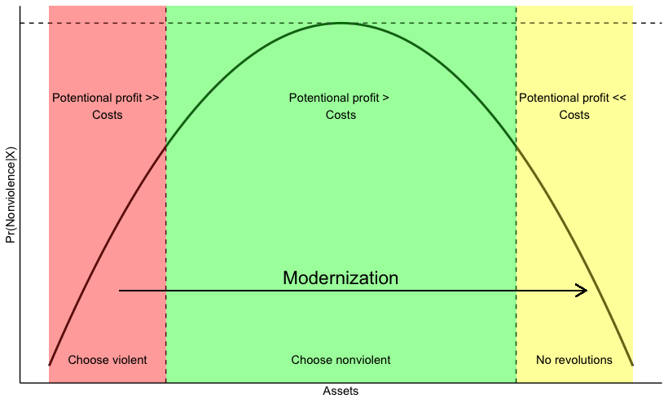
How economic well-being affects revolutions?
H: GDP per capita has hump-shaped association with risks of nonviolent revolutions onset
Modernization theory + relative deprivation: in societies in modernization risks of instability are higher (Huntington; Gurr 1970; Butcher & Svensson 2016)
Rationale choice theory (“has nothing to loose but chains” -> “want more”)
Survival -> Self-expression -> Middle class wants rights (Inglehart and Welzel 2005)
State capacity (Wimmer, Cederman, and Min 2009)

Slide 8
Materials & Methods
Estimator
Logistic regression with special estimator (ML fails, see Firth 1993)
Dependent variable
Start of unarmed revolution¹ => binary indicator
Independent variable
GDP per capita (PPP, 2017$)² => continuous variable
Second degree polynomial to produce “U-shape”
Data
Panel data with country-year as a unit of analysis
All countries, 1950-2019 (~9000 n)
Controls: democracy³, oil wealth⁴, demography⁵, education⁶, revolution tradition⁷, corruption⁸, urbanization⁹
Fixed effects (years)
Clustered SE (countries)
Sources:
¹NAVCO 1.3, Beissinger & Goldstone
²Gapmider
³Polity-V; ⁴Our world in data; ⁵WPP;
⁶UNDP; ⁷DV data; ⁸V-Dem; ⁹WB

Slide 9
Results-1
Variable | NAVCO 1.3 |  |  |  | Beissinger's Data
 | b | b MI | z | z MI | b | b MI | z | z MI
(Intercept) | -28.440 | -29.644 | -5.76 | -6.76 | -23.535 | -28.918 | -4.02 | -5.20
GDP pc, ln | 5.873 | 5.555 | 5.22 | 5.40 | 5.440 | 5.837 | 3.93 | 4.60
GDP pc, ln, sq | -0.356 | -0.316 | -5.51 | -5.37 | -0.333 | -0.337 | -3.94 | -4.54
Economic growth | -0.037 | -0.027 | -3.18 | -2.94 | -0.049 | -0.041 | -4.32 | -4.56
Population, ln | 0.266 | 0.306 | 5.06 | 7.07 | 0.165 | 0.241 | 2.42 | 3.81
Polity | -0.007 | -0.009 | -0.45 | -0.64 | -0.016 | -0.017 | -0.82 | -0.92
Polity sq | -0.010 | -0.010 | -2.73 | -3.63 | -0.010 | -0.010 | -2.77 | -3.15
Regime’s Durability | -0.012 | -0.009 | -3.11 | -2.33 | -0.014 | -0.015 | -3.33 | -3.07
Urbanization | -0.002 | -0.003 | -0.40 | -0.73 | 0.001 | 0.004 | 0.29 | 0.83
Corruption | 0.683 | 0.672 | 2.12 | 2.27 | 1.096 | 1.036 | 2.45 | 2.58
Mean years of schooling | 0.021 | -0.010 | 0.50 | -0.25 | -0.065 | -0.054 | -1.04 | -0.92
Youth bulge | -7.166 | -5.229 | -3.99 | -3.31 | -13.474 | -8.976 | -6.00 | -4.62
Oil production pc, ln | 0.000 | -0.014 | 0.02 | -0.96 | -0.034 | -0.055 | -1.74 | -2.84
Region’s Revolutions, t | 0.246 | 0.339 | 1.02 | 1.45 | 0.640 | 0.525 | 2.45 | 2.06
Region’s Revolutions, t-1 | 0.517 | 0.489 | 3.37 | 3.38 | 0.220 | 0.207 | 1.33 | 1.08
N – 6361
N MI – 9472
Clustered SE (countries)
FE on years (1950-2019)
All variables at t-1

Slide 10
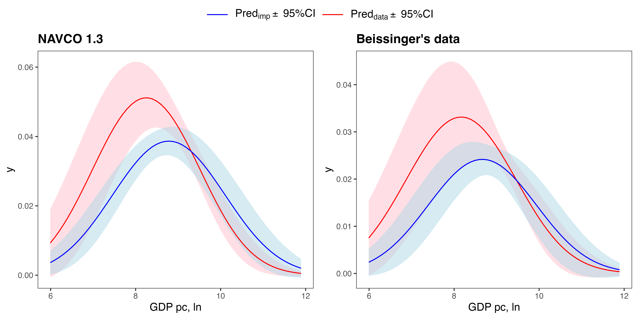
Results-2
Adjusted Predictions of GDP pc, ln
Red – initial estimates (n = 6361)
Blue – Multiple imputation (100 datasets, n = 9472)

Slide 11
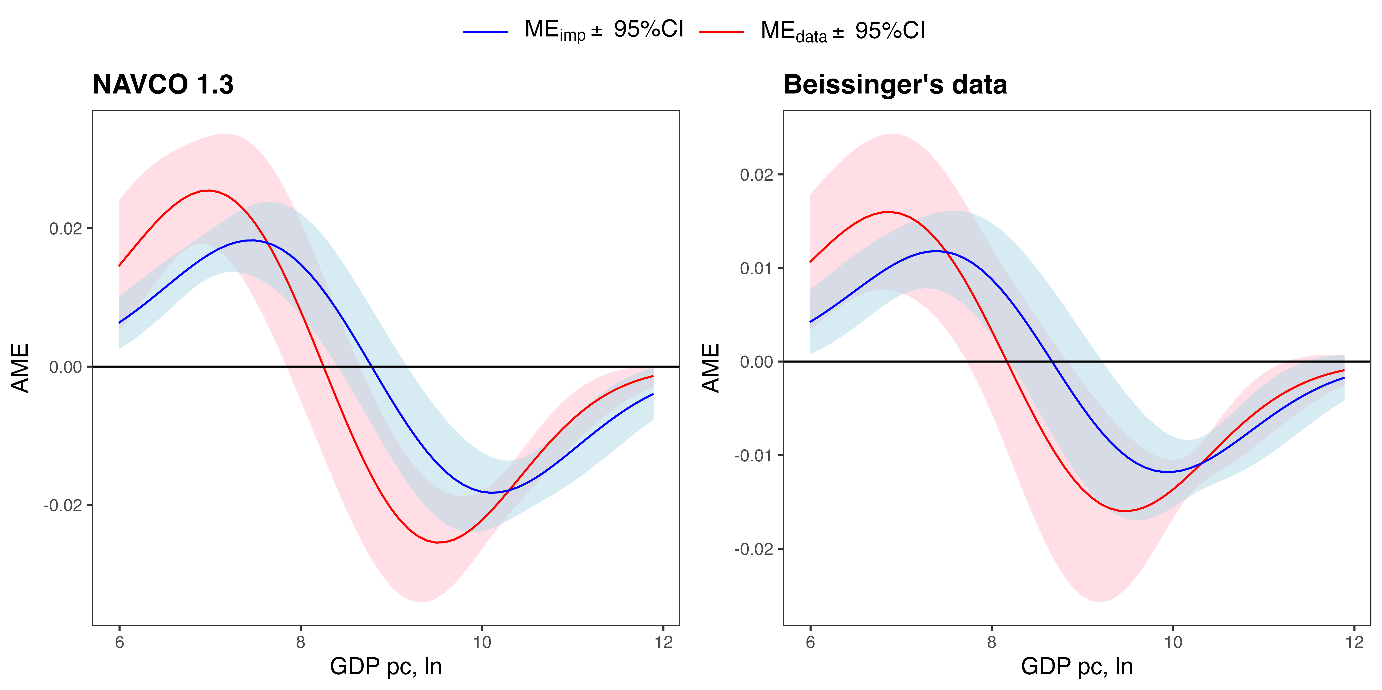
Results-3
Marginal Effect of GDP pc, ln
Red – initial estimates (n = 6361)
Blue – Multiple imputation (100 datasets, n = 9472)

Slide 12
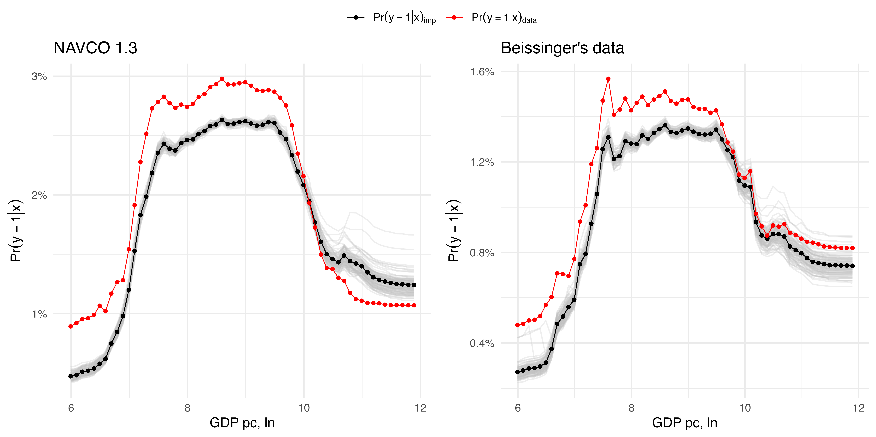
Results-4
Partial Effect of GDP pc, ln (Random Forest RFQ)
Red – initial estimates (n = 6361)
Black – Multiple imputation (100 datasets, n = 9472)

Slide 13
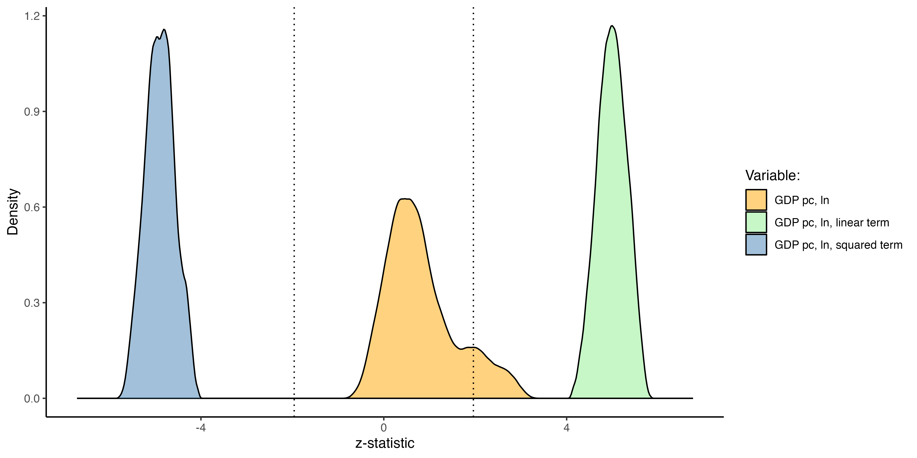
Robustness 1 – Extreme Boundary Analysis
Idea – run set of regressions with all possible controls combinations
Check for selection bias + omitted factors

Slide 14
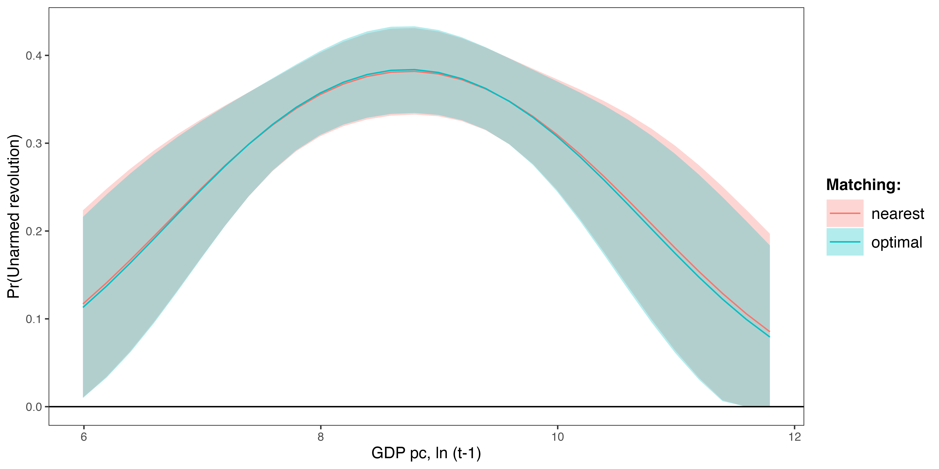
Robustness 2 – Matching
Idea – make balanced “case-control” quasi-random sample
Check for sensitivity

Slide 15
Discussion – Technical issues
Endogeneity?
Reverse causality - variables at t-1
Omitted variables – lots of controls
Time-variant variance is blocked by FE
Selection bias/missings bias – Multiple Imputations
Robust?
Multiple imputation
Extreme boundary analysis
Parametric and Non-parametric methods
U-shape?
Marginal effect to check areas of significance
Non-parametric procedure without assumptions
Operationalization?
Just 1 operationalization of IV
2 operationalization of DV

Slide 16
Discussion – Theoretical issues
In-line with democratization studies:
Przeworski and colleagues (2000): democratic transition is more probable at the middle level of development.
Is violent vs. nonviolent dichotomy correct?
Not at all, nonviolent revolutions are heterogenous – limitation

Slide 17
Conclusion
U-shape hypothesis is supported
Two contradictory trends in economic development:
State-capacity decreases the odds of nonviolent revolution
Opportunity-costs increases the odds of nonviolent revolution
The probability of unarmed revolutions:
Low in low-income and high-income countries
The highest in the middle-income countries
New view on the “middle-income trap” problem

