Slide 1
Wealth and Rebellion: A Dualistic Perspective on Income Level and Revolutions
Faculty of Social Science
Center for Stability and Risk Analysis
Moscow,
2024
Ustyuzhanin Vadim
Junior research fellow
Center for Stability and Risk Analysis

Slide 2
Novelty (1)
“Income growth and revolutions” (Knutsen, 2014):
Short-term growth is significantly and negatively associated with revolutionary attempts
Income level (GDP per capita) is significantly and negatively associated with revolutionary attempts
However!
No separation on violent/nonviolent revolutions (Butcher et al., 2022; Pischedda, 2020; Rasler et al., 2022; Stephan & Chenoweth, 2008)
Assumption about linearity (Beissinger, 2022; Ustyuzhanin et al., 2023)
Inappropriate methodology (ML estimator for rare events)
“Revolution is a collective mobilization that attempts to quickly and forcibly overthrow an existing regime in order to transform political, economic and symbolic relations” (Lawson, 2019, p. 5)

Slide 3
Novelty (2) – GDP pc in Revolutionary studies
All |  | Nonviolent |  | Violent
Knutsen, 2014 | Negative significant | Rørbæk, 2019 | Significant positive | Beissinger, 2022 | Negative significant
Albrecht & Koehler, 2020 | Significant Positive | Gleditsch & Rivera, 2017 | Insignificant negative | Besançon, 2005 | Negative significant
Keller, 2012 | Insignificant (positive + negative) | Dahl, Gates, Gleditsch, González, 2021 | Insignificant positive | Cincotta & Weber, 2021 | Negative significant
Djuve et al., 2020 | Negative significant | Chenoweth & Ulfelder, 2017 | Insignificant | Wimmer et al., 2009 | Negative significant
Beissinger, 2022 | Insignificant positive | Chenoweth & Lewis, 2013 | Insignificant positive | Fox, 2004 | Negative insignificant

Slide 4
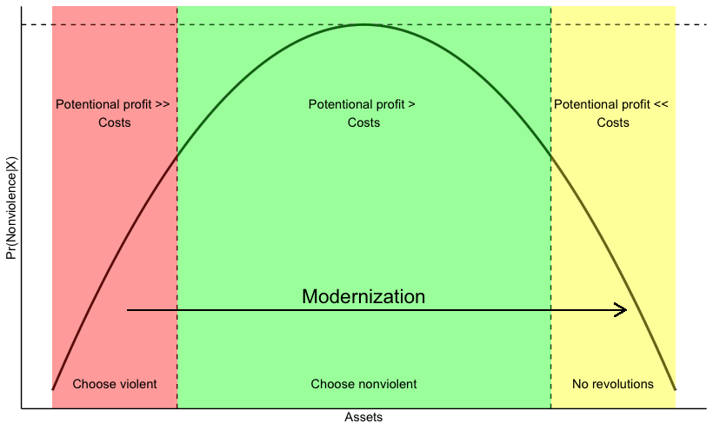
How economic well-being affects revolutions?
H1: GDP per capita is linearly negatively and significantly affects probability of violent revolution onset
Rationale choice theory: costs of violence too big when there are huge investments in capital (Bueno de Mesquita, 1985; Sambanis 2001; Besançon 2005)
Modernization theory: Modernized societies are saved from revolutions (Huntington)
“there is now consensus that the risk of war decreases as average income increases” (Hegre & Sambanis, 2006, pp. 508–509)
H2: GDP per capita has hump-shaped association with risks of nonviolent revolutions onset
Modernization theory + relative deprivation: in societies in modernization risks of instability are higher (Huntington; Gurr 1970; Butcher & Svensson 2016)
Rationale choice theory (“has nothing to loose but chains” -> “want more”)
Survival -> Self-expression -> Middle class wants rights (Inglehart and Welzel 2005)
State capacity (Wimmer, Cederman, and Min 2009)

Slide 5
Materials & Methods
Dependent:
Nonviolent revolution onset (NAVCO 1.3, Korotayev + Beissinger dataset) – binary (Highly imbalanced data)
Independent:
GPD per capita (PPP, 2017$)
Economic growth = f(GDP pc)
Controls: democracy, oil rent, population, education, etc
Unit of analysis:
country-year (panel imbalanced data)
Highly imbalanced dependent var (for one “1” there are a hundred “0”)
1950-2019 with all countries (~9 000 n)
Methodological strategy:
Parametric:
Logistic ”rare events” regression (ML estimator with penalty) – Firth 1993
Nonparametric:
Imbalanced classification trees with G-Mean optimization (quantile-classifier approach of O'Brien and Ishwaran (2017))
Fixed effects (one-way by time), clustered SE
Multiple Imputation (100 datasets),
All variables with lag (endogeneity concerns)

Slide 6
Results-1
Variable | NAVCO 1.3 |  |  |  | Beissinger's Data
 | b | b MI | z | z MI | b | b MI | z | z MI
(Intercept) | -28.440 | -29.644 | -5.76 | -6.76 | -23.535 | -28.918 | -4.02 | -5.20
GDP pc, ln | 5.873 | 5.555 | 5.22 | 5.40 | 5.440 | 5.837 | 3.93 | 4.60
GDP pc, ln, sq | -0.356 | -0.316 | -5.51 | -5.37 | -0.333 | -0.337 | -3.94 | -4.54
Economic growth | -0.037 | -0.027 | -3.18 | -2.94 | -0.049 | -0.041 | -4.32 | -4.56
Population, ln | 0.266 | 0.306 | 5.06 | 7.07 | 0.165 | 0.241 | 2.42 | 3.81
Polity | -0.007 | -0.009 | -0.45 | -0.64 | -0.016 | -0.017 | -0.82 | -0.92
Polity sq | -0.010 | -0.010 | -2.73 | -3.63 | -0.010 | -0.010 | -2.77 | -3.15
Regime’s Durability | -0.012 | -0.009 | -3.11 | -2.33 | -0.014 | -0.015 | -3.33 | -3.07
Urbanization | -0.002 | -0.003 | -0.40 | -0.73 | 0.001 | 0.004 | 0.29 | 0.83
Corruption | 0.683 | 0.672 | 2.12 | 2.27 | 1.096 | 1.036 | 2.45 | 2.58
Mean years of schooling | 0.021 | -0.010 | 0.50 | -0.25 | -0.065 | -0.054 | -1.04 | -0.92
Youth bulge | -7.166 | -5.229 | -3.99 | -3.31 | -13.474 | -8.976 | -6.00 | -4.62
Oil production pc, ln | 0.000 | -0.014 | 0.02 | -0.96 | -0.034 | -0.055 | -1.74 | -2.84
Region’s Revolutions, t | 0.246 | 0.339 | 1.02 | 1.45 | 0.640 | 0.525 | 2.45 | 2.06
Region’s Revolutions, t-1 | 0.517 | 0.489 | 3.37 | 3.38 | 0.220 | 0.207 | 1.33 | 1.08
N – 6361
N MI – 9472
Clustered SE (countries)
FE on years (1950-2019)
All variables at t-1

Slide 7
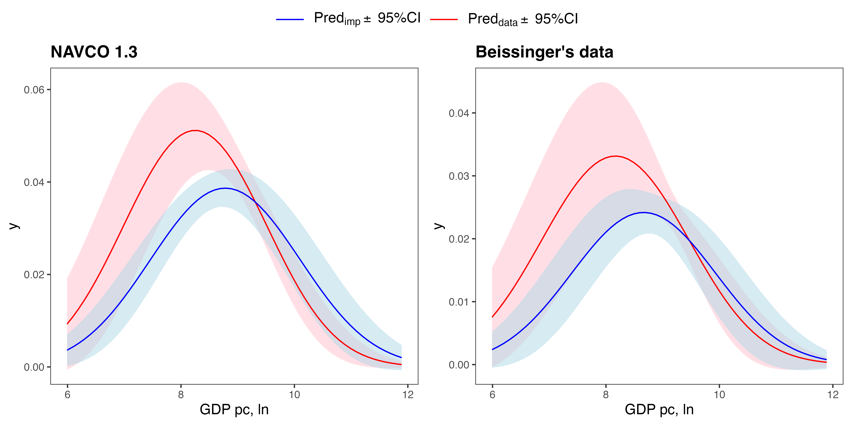
Results-3
Adjusted Predictions of GDP pc, ln
Red – initial estimates (n = 6361)
Blue – Multiple imputation (100 datasets, n = 9472)

Slide 8
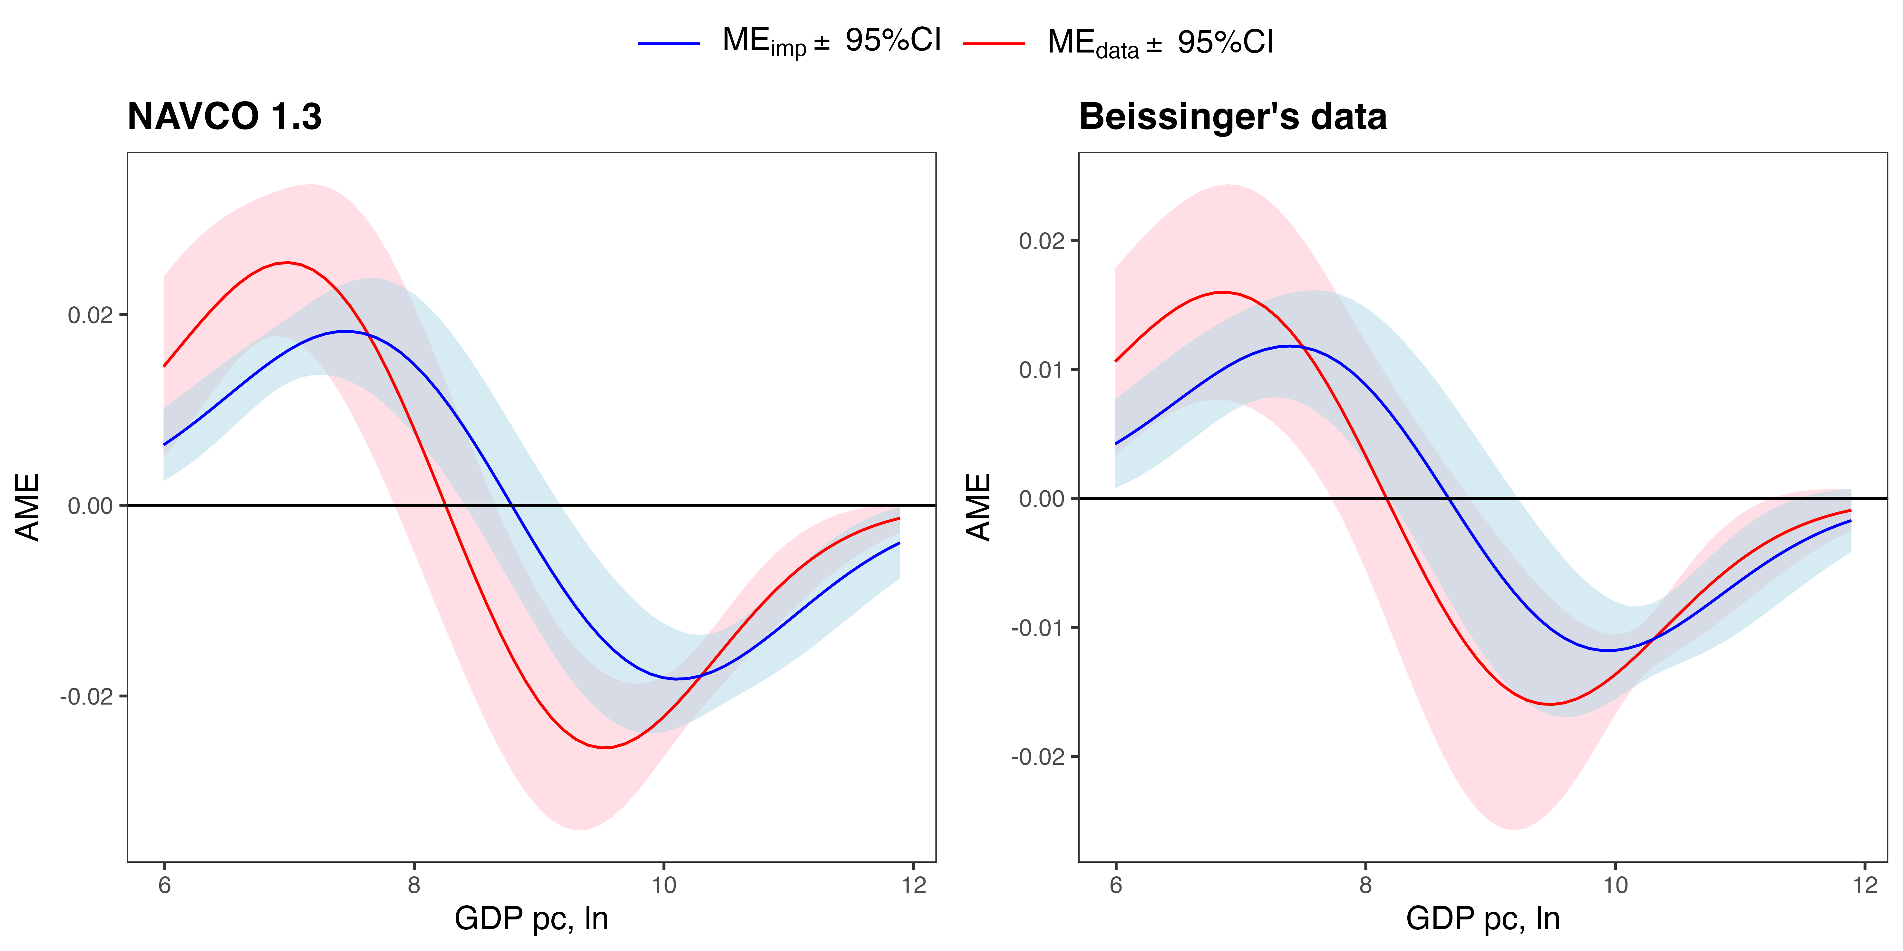
Results-2
Marginal Effect of GDP pc, ln
Red – initial estimates (n = 6361)
Blue – Multiple imputation (100 datasets, n = 9472)

Slide 9
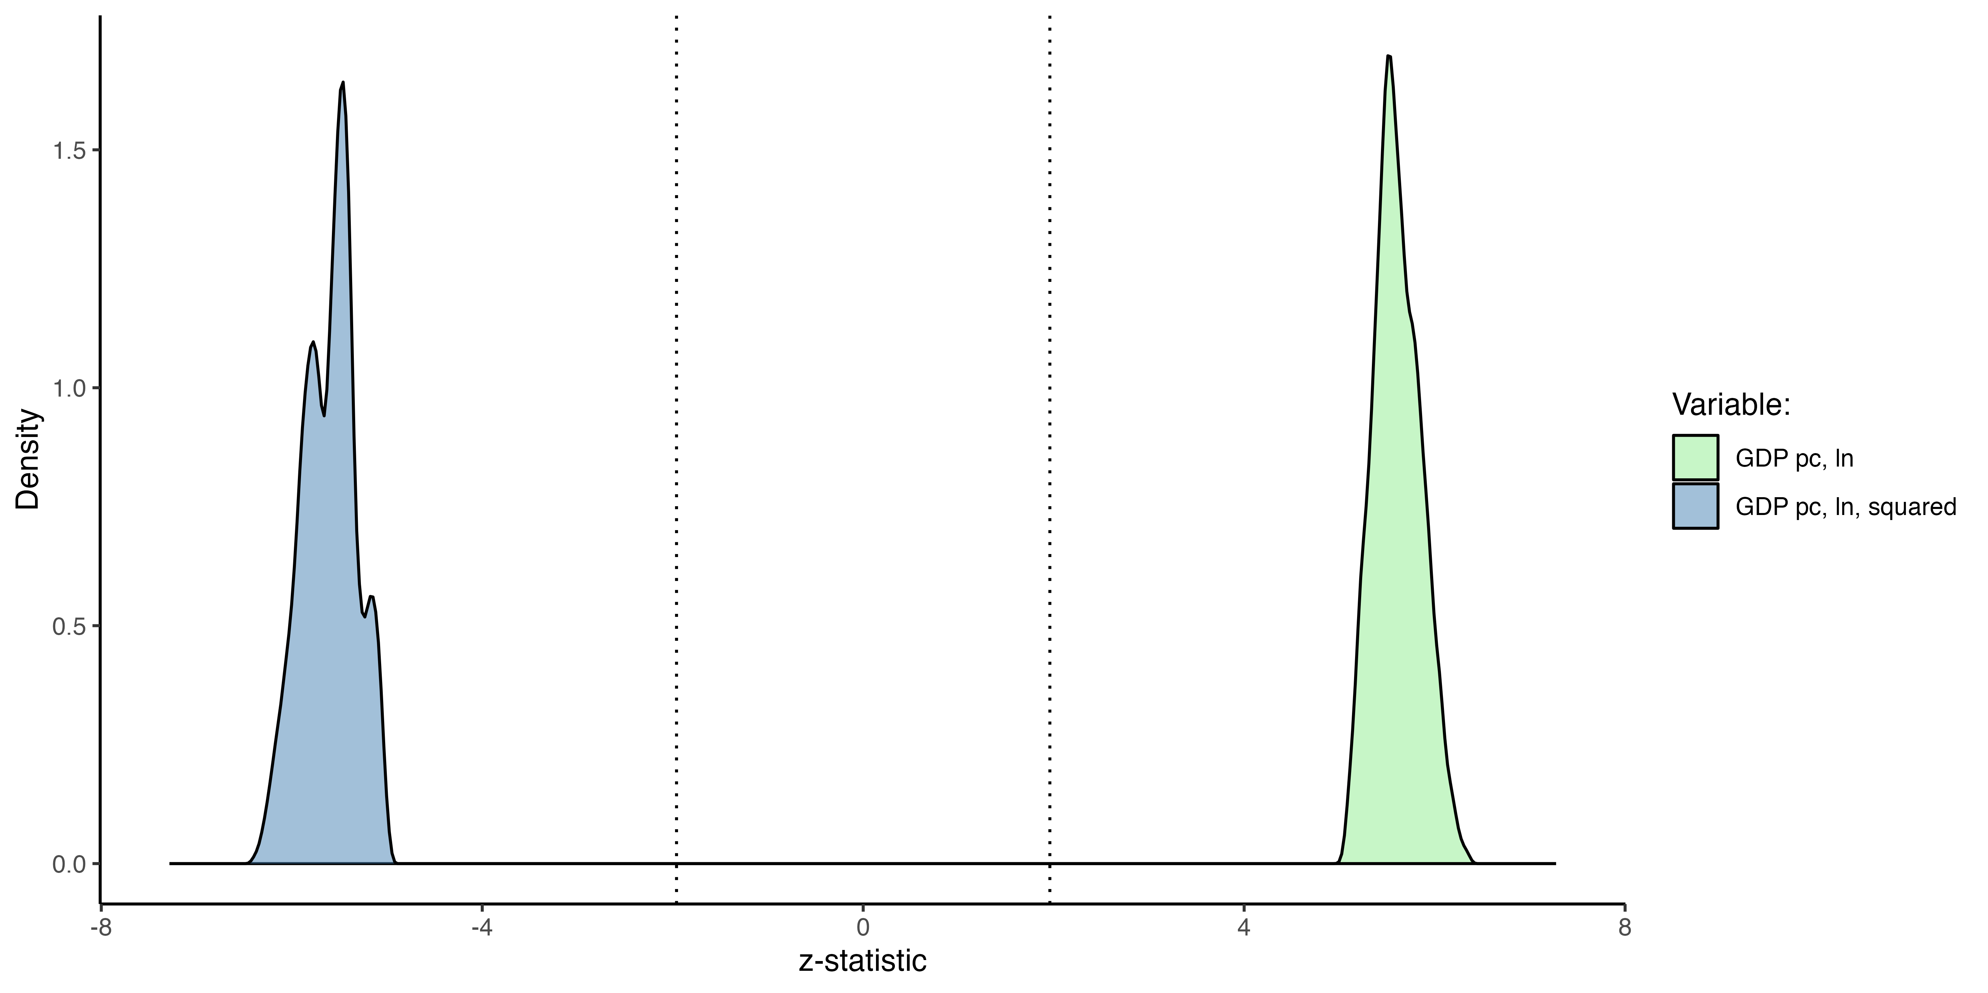
Results-3
Extreme Boundary Analysis
Idea – run set of regressions with all possible controls combinations
Number of models (9 controls)

Slide 10
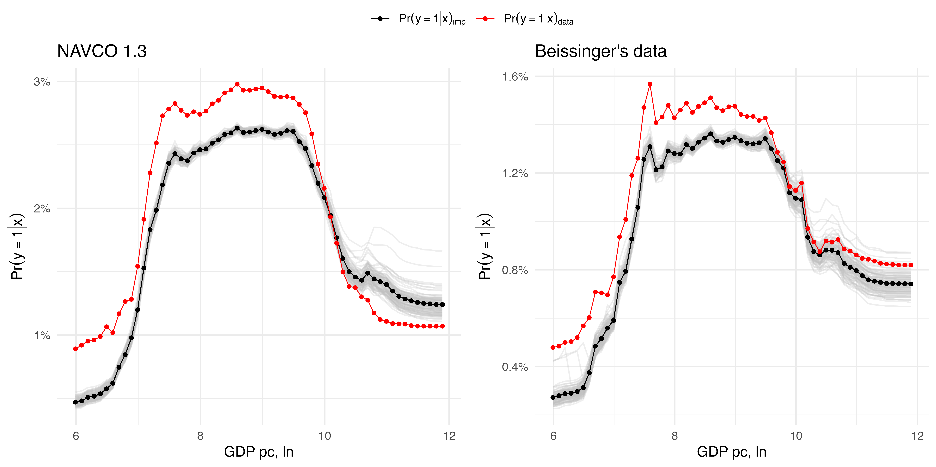
Results-3
Partial Effect of GDP pc, ln (Random Forest RFQ)
Red – initial estimates (n = 6361)
Black – Multiple imputation (100 datasets, n = 9472)

Slide 11
Discussion
Endogeneity?
Variables at t-1
Omitted variables – lots of controls
Time-variant variance is blocked by FE
Selection bias – Multiple Imputations
Robust?
Multiple imputation
Extreme boundary analysis
Parametric and Non-parametric methods
U-shape?
Marginal effect to check areas of significance
Non-parametric procedure without assumptions
Operationalization?
Just 1 operationalization of IV
2 operationalization of DV

Slide 12
References
Methods:
Firth D (1993). Bias reduction of maximum likelihood estimates. Biometrika. 80, 27-38.
Kosmidis, I., Kenne Pagui, E. C., & Sartori, N. (2020). Mean and median bias reduction in generalized linear models. Statistics and Computing, 30(1), 43–59
O’Brien, R., & Ishwaran, H. (2019). A random forests quantile classifier for class imbalanced data. Pattern Recognition, 90, 232–249.
King, G., Honaker, J., Joseph, A., & Scheve, K. (2001). Analyzing Incomplete Political Science Data: An Alternative Algorithm for Multiple Imputation. American Political Science Review, 95(1), 49–69.
Honaker, J., King, G., & Blackwell, M. (2011). Amelia II: A Program for Missing Data. Journal of Statistical Software, 45(7).
Sala-i-Martin, X. (1997). I Just Ran Two Million Regressions. 87(2), 178–183.
Data:
Chenoweth, E., & Christopher, W. S. (2020). List of Campaigns in NAVCO 1.3. Harvard Dataverse.
Beissinger, M. (2022). The Revolutionary City: Urbanization and the Global Transformation of Rebellion. Princeton University Press.
Goldstone, J. A., Grinin, L., Ustyuzhanin, V., & Korotayev, A. (2023). Revolutionary Events of the 21st Century: A Preliminary Quantitative Analysis. Polis. Political Studies (In Russ.), 4, 54–71.

