Slide 1
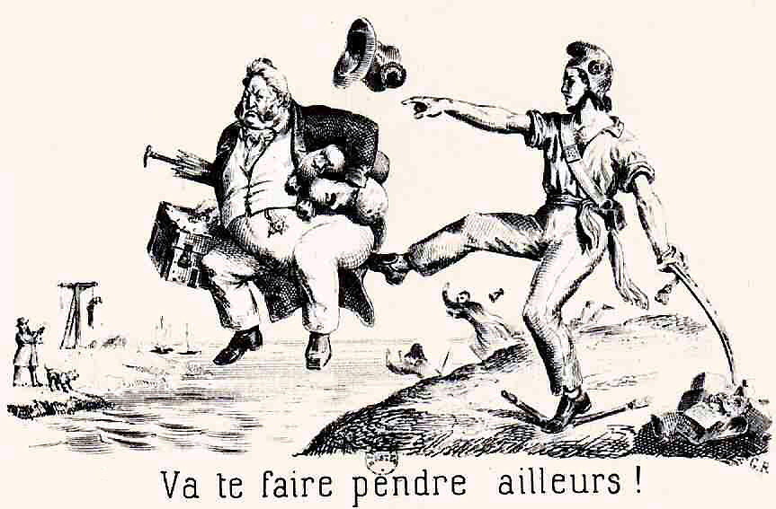
Democracy by Mistake
Daniel Treisman
University of California, Los Angeles
November 2017

Slide 2
How democratization occurs – a puzzle.
Authoritarian ruling elite must relinquish—or at least share—power.
Why would they do that?
2
Daniel Treisman Democracy by Mistake /22

Slide 3
Various theories suggest they do so deliberately…
to credibly commit to future income redistribution, so poor won’t revolt (Acemoglu and Robinson 2006).
to motivate citizens to defend country (Tichi and Vindigni 2008).
to nudge future governments away from patronage towards public good provision (Lizzeri and Persico 2004).
to win support in intra-elite competition (e.g. Llavador and Oxoby 2005, Collier 1999).
as “great compromise” between deadlocked factions (Rustow 1970), perhaps formalized in a “pact” (O’Donnell and Schmitter 1986).
3
Daniel Treisman Democracy by Mistake /22

Slide 4
All these assume the elite (or at least part of it) means to give up/share power.
But does it?
Reading the history –
chaos, myopia,
miscalculations…
My conjecture: democracy often emerged not because incumbents deliberately chose it, but because, in seeking to prevent it, they messed up. Democracy by mistake.
4
Daniel Treisman Democracy by Mistake /22

Slide 5
Research strategy
Identify all cases of democratization 1820-2015, using 3 widely used definitions:
Total: 201
Read history, newspapers, memoirs, interviews, other sources.
Categorize whether each case could at least somewhat plausibly fit each of the “deliberate choice” arguments. Set bar low.
Code whether each case resulted from some mistake(s) of incumbent. If so what kind?
Polity2 jump of 6 points in 3 years | Polity2 “Major Democratic Transition” | Boix, Miller, Rosato (2013) authoritarian to democracy
153 | 138 | 129
5
Daniel Treisman Democracy by Mistake /22

Slide 6
What do I mean by a mistake?
course of action or inaction, the expected payoff of which is lower than that of some other feasible course.
In game theoretic terms, an action that is off the equilibrium path in a game of complete and perfect information.
Two kinds of mistakes: errors of information and errors of calculation.
Not all actions with undesired outcomes = mistakes. Can lose a gamble that was optimal ex ante. Or pick “lesser evil.”
Action may be a mistake even if all options were bad. So long as one other feasible course had a higher expected payoff.
6
Daniel Treisman Democracy by Mistake /22

Slide 7
What do I mean by a mistake?
I don’t assume leaders always prioritize staying in power. If they step down to avoid bloodshed, not in itself a mistake.
Not saying that dictators are stupid. Cicero: “We must not say that every mistake is a foolish one.” Ruling is hard.
Am suggesting that democratization may have resulted less from deliberate choice by elites than from their misperceptions and miscalculations.
7
Daniel Treisman Democracy by Mistake /22

Slide 8
Results
Based on my review of the historical evidence,
Deliberate choice explanations 28-33%
Mistakes by incumbents 64-67%
Detailed synopses of each case, historical details, historians’ interpretations, etc., to justify my codings.
8
Daniel Treisman Democracy by Mistake /22

Slide 9
Deliberate choice explanations
Argument | Might have contributed | Examples
Commit to redistribute, forestall revolution | 6-8 % | UK 1884, South Africa 1994
Motivate citizens to fight war or civil war | 4-5% | Italy in Libya 1912
Substitute public goods for patronage | 4% | Ottoman Empire 1876
Win supporters for intra-elite competition | 5-10% | UK 1884, Uruguay 1915-16
“great compromise” among factions/“pact” | 14-16%/ 16-19% | Venezuela 1958, Uruguay 1984
9
Daniel Treisman Democracy by Mistake /22

Slide 10
Mistakes by incumbents
Type of mistake | % of cases | Examples
Hubris 1: Ignore warnings and get overthrown in mass revolt | 13-17% | Louis-Philippe in France 1848
Hubris 2: Call election/ referendum and lose | 24-29% | Pinochet in Chile 1988
Military adventure: Start or enter war and lose | 6-9% | Galtieri in Argentina 1982
Slippery slope: Start partial reform and lose control | 30-34% | Gorbachev in USSR, late 1980s
Trusting a traitor: Elite appoints leader to preserve regime who destroys it | 7-10% | Juan Carlos and Adolfo Suárez, Spain late 1970s
Counterproductive violence | 12-15% | Ershad in Bangladesh 1990
10
Daniel Treisman Democracy by Mistake /22

Slide 11
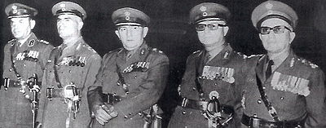
How do I decide how to classify cases? An example: Greece 1974.
1967: Junta of colonels seizes power.
1974: civilian rule restored.
Do the details fit any of the deliberate choice explanations?
11
Daniel Treisman Democracy by Mistake /22

Slide 12
Did a rich elite democratize to commit to redistribution to the poor, prevent revolution (Acemoglu Robinson 2006)?
-incumbents were not a rich elite: they were a military faction.
-junta in 1974—under Brigadier Dimitrios Ioannidis—had no intention of democratizing. Ioannidis overthrew previous leader, Giorgios Papadopoulos, when he began to liberalize.
-protests did occur, led by students rather than the poor. Colonels did not respond by making democratic concessions: they sent tanks to crush them.
-regime lost power when, responding to Turkish invasion of Cyprus, leading generals overthrew Ioannidis. They appointed a conservative politician, Konstantinos Karamanlis, as prime minister. No commitment to redistribution involved.
12
Daniel Treisman Democracy by Mistake /22

Slide 13
Did the military democratize to motivate citizens to fight or reward them for fighting?
-Conflict with Turkey was the trigger for the junta’s collapse.
-But military did not democratize to persuade citizens to fight because, after Ioannidis’s overthrow, leaders were determined to avoid war.
-Joint chiefs of staff “agreed that war was impossible” (Woodhouse 1985). Karamanlis “at once made it clear that there could be no question of a military confrontation with Turkey” and ordered demobilization (Clogg 1975).
An attempt to nudge future governments towards public good provision?
-No. Doesn’t apply at all.
13
Daniel Treisman Democracy by Mistake /22

Slide 14
Was it a case of one elite faction broadening access in the hope of winning votes?
-No. Junta was certainly not angling for votes, and it did not mean to democratize.
A “great compromise” or pact?
-Karamanlis did initially form a government of national unity—but one that totally excluded the left.
-He made decisions “explicitly avoiding reaching any ‘settlement’—let alone a ‘pact’—with other democratic political leaders” (Sotiropoulos 2002).
So does not fit any of these deliberate choice theories.
14
Daniel Treisman Democracy by Mistake /22

Slide 15
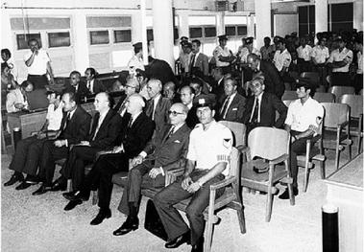
Democratization by mistake?
Yes—military adventure. Junta did not mean to democratize. It began a military confrontation with Turkey over Cyprus—but failed, undermining its own support base.
The colonels on trial, 1975
15
Daniel Treisman Democracy by Mistake /22

Slide 16
Robustness: Does it make a difference to the results
which era/wave of democracy?
whether the democratization proved permanent?
whether the historical sources were more or less comprehensive?
Deliberate choice arguments do a bit better in “first wave” cases, up to 1927.
Still, except for elite party competition—which may have contributed in 6 of the 16 cases (by BMR criterion)—no single argument helps to explain even ¼ of first wave cases.
In each wave, democratization resulted more often from mistakes than deliberate choices of elites.
Results similar for temporary and permanent democratizations, and for those with better sources and those with worse sources available.
16
Daniel Treisman Democracy by Mistake /22

Slide 17
Of course, not saying all mistakes of dictators lead to democratization.
Some lead to nothing. When they do prompt regime change, underlying “structural” conditions must be right for democracy.
But in explaining how the elite comes to democratize, mistakes are much more important than previously thought.
17
Daniel Treisman Democracy by Mistake /22

Slide 18
Why so many mistakes?
Common cognitive biases and limitations
-over-optimism (Krizan and Windschitl 2007).
-overconfidence (Lichtenstein, Fischhoff and Phillips 1982).
-dissonance reduction (Festinger 1957).
-the “ostrich syndrome” (Karlsson, Loewenstein and Seppi 2009).
-the “illusion of control” (Langer and Roth 1975).
18
Daniel Treisman Democracy by Mistake /22

Slide 19
Why so many mistakes?
Pathologies of authoritarian leaders
-hubris an “acquired personality disorder” Owen and Davidson (2009).
-self-isolation, banishing of bearers of bad news and critical thinkers.
-superstition.
-physical and mental deterioration (cannot retire safely).
Authoritarian environment
-preference falsification, unreliable and volatile polls.
19
Daniel Treisman Democracy by Mistake /22

Slide 20
Other types of institutional change where mistakes appear important
Selection of electoral rules (PR, majoritarian). Incumbents have often “supported electoral rules that later eliminated them from politics” (Andrews and Jackman 2005).
Spread of human rights treaties (Sikkink 2011). Pinochet approves UN Convention Against Torture—a judge later uses it to demand his extradition.
20
Daniel Treisman Democracy by Mistake /22

Slide 21
Conclusions
based on comprehensive review of historical cases, democratization was a deliberate choice of incumbents in up to 1/3 of cases.
in about 2/3, incumbents did not intend to democratize, but ended up doing so because of mistakes they had made.
Common mistakes of dictators include hubris, military adventures, slippery slope reforms, trusting covert democrats, and counterproductive violence.
mistakes should not surprise us in complex social situations that do not occur often enough for actors to learn from practice—like institutional change.
21
Daniel Treisman Democracy by Mistake /22

Slide 22
Thank you
22
Daniel Treisman Democracy by Mistake /22

