Slide 1
Subjective feeling of happiness and a level of social and political instability: towards a cross-cultural perspective
Alisa R. Shishkina
Higher School of Economics

Slide 2
Subjective feeling of happiness in the Arab world
Despite the notable successes in the field of economic and social development in the 2000s in the Arab world, the population of many Arab countries showed a decrease in the level of satisfaction with standard of living.
“Paradox of unhappy development”
Davies’ J-curve
Gurr’s theory of relative deprivation

Slide 3
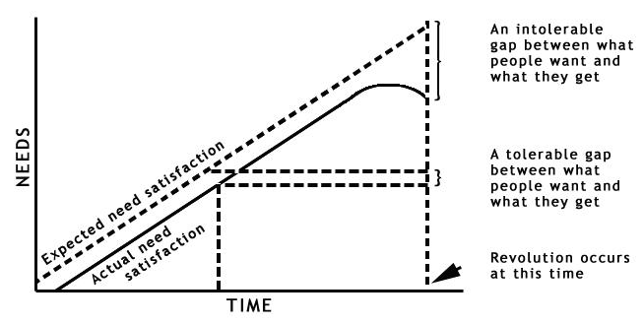
Davies' J-curve

Slide 4
Theory of relative deprivation
Relative deprivation is associated with a gap between the need for a good on the one hand, and the conditions upon which people have to rely, on the other, and inevitably leads to frustration that could ultimately provoke political violence.
Special attention should be paid to the adjective "relative", which means that this condition is not absolute and is the result of comparing of people to others, i.e. different social groups may have differently perceive almost identical circumstances.

Slide 5
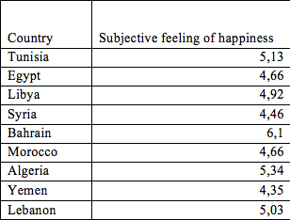
The level of subjective feeling of happiness, according to the World Happiness Database

Slide 6
Correlation between the level of subjective happiness index coefficients and socio-political instability

Slide 7
QCA analysis
Destab. = f(Happ., Wom., Soc., Confl.)
Positive outcomes (Tunisia, Egypt, Libya, Syria, Yemen)
Negative outcomes (Bahrain, Morocco, Algeria, Lebanon)

Slide 8
QCA analysis
For positive outcomes, the necessary but not sufficient condition for the change of political regime is a combination of factors such as the absence of subjective feeling of happiness and active participation of women in the protests.
For negative configurations, the combination of the subjective feeling of happiness and the absence of football fans in the political space of the country are sufficient but not necessary.

Slide 9
Thank you for your attention!

