Slide 1
International Master in COMPARATIVE SOCIAL RESEARCH
Dr. Christian Fröhlich
Assistant Professor
Department of Sociology, Faculty of Social Sciences
Higher School of Economics , Moscow, 2015
www.hse.ru

Slide 2
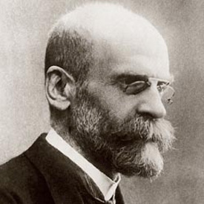
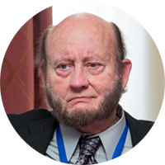
Comparative Sociology
”Comparative sociology is not a particular branch of sociology; it is sociology itself, in so far as it ceases to be purely descriptive and aspires to account for facts”
(Emile Durkheim, 1895: The Rules of Sociological Method)
photo
Aim to shed light on the differences between nations, cultures and other social groups
„The International Comparative Social Research program is designed to provide insight into how societies are evolving, and to what extent given social policies are successful.”
(Ronald Inglehart, University of Michigan)
Higher School of Economics , Moscow, 2015

Slide 3
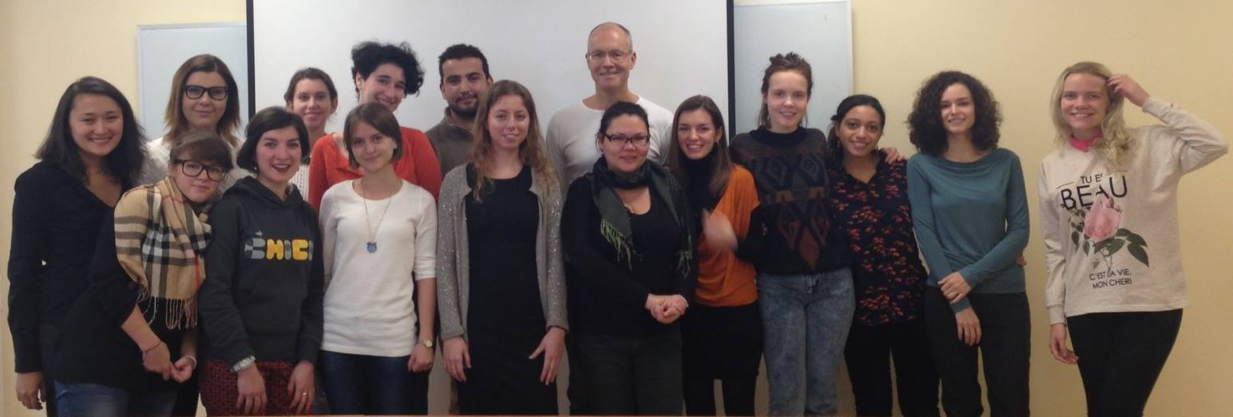
Who should apply?
Strong interest and educational background in social sciences or humanities (political science, sociology, anthropology, psychology, history)
Considering an international research/academic career
Wish to work in the field of applied research analysis (in international organizations and companies)
Decent level of English
Study together with both Russian and international students
photo
photo
photo
Higher School of Economics , Moscow, 2015

Slide 4
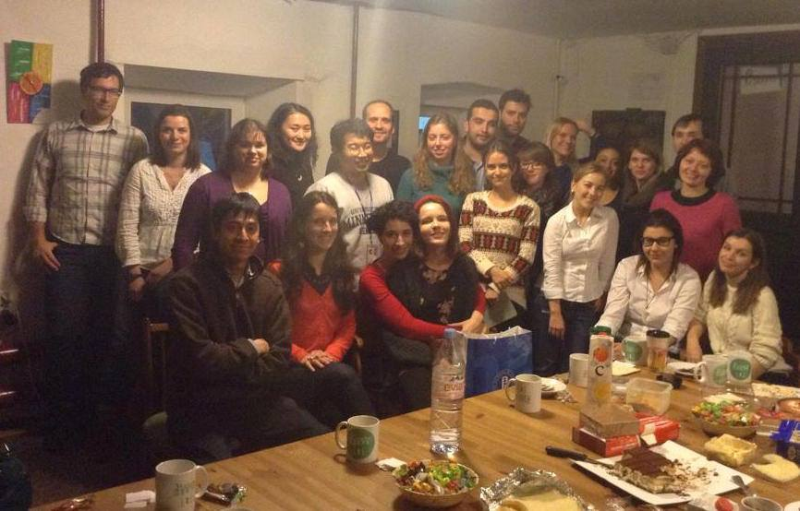
Master Program highlights and structure
25 study places available
20 budget places
2-year master program (120 ECTS)
Instruction in English
International lecturers
HSE inter-campus mobility
Research internship in Russia or abroad
Publication in peer-reviewed journal
photo
photo
photo
Higher School of Economics , Moscow, 2015

Slide 5
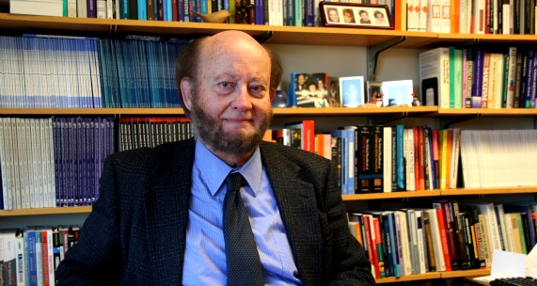
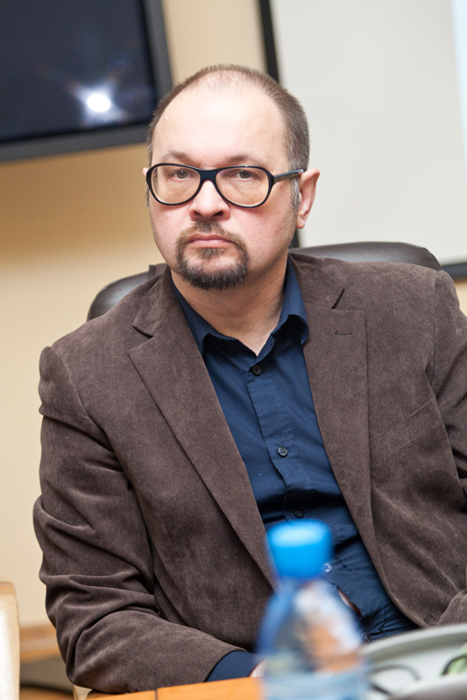
The Laboratory for Comparative Social Research – Higher School of Economics
photo
The Laboratory for Comparative Social Research (LCSR) was established in the National Research University Higher School of Economics, in November 2010 when professors Ronald Inglehart and Eduard Ponarin were awarded a mega-grant from the Russian government.
photo
poto
Higher School of Economics , Moscow, 2015

Slide 6
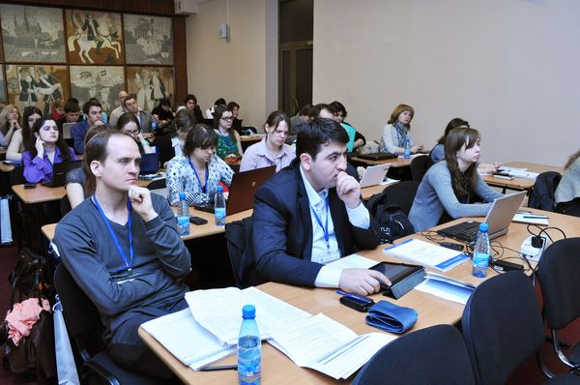
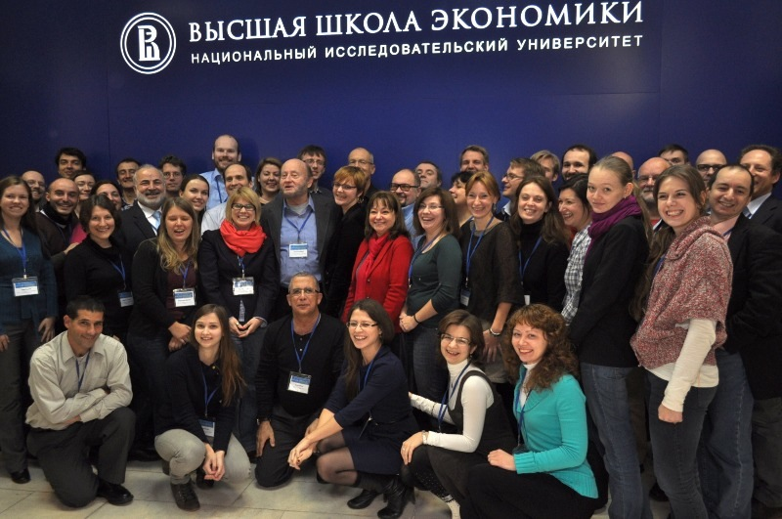
The Laboratory for Comparative Social Research – Higher School of Economics
Research: comparative quantitative studies of social change with focus on norms & values (using WVS data in more than 50 projects)
Annual conferences/international workshops (April 4th 2016)
International summer schools (July 30 – August 12, 2016)
Weekly seminars (Moscow and St. Petersburg)
International research network (access to top experts, joint research)
Opportunities for young researchers (PhD students mobility)
photo
photo
poto
Higher School of Economics , Moscow, 2015

Slide 7
The Laboratory for Comparative Social Research – Higher School of Economics
photo
photo
poto
Higher School of Economics , Moscow, 2015

Slide 8
Master Program highlights and structure
1st year
2nd year
Basic social theory and methods training
(Moscow campus)
Research internship with partner institution in Russia or abroad
Publication in peer-reviewed journal
photo
Modules 1-2
photo
Advanced Methods and Thematic Focus
(St.Petersburg campus)
Master thesis writing and defense
(Moscow or St. Petersburg)
Modules 3-4
photo
Higher School of Economics , Moscow, 2015

Slide 9
Program curriculum 2015/16
Methods:
Quantitative methods,
Qualitative methods,
Multi-level regression analysis,
Questionnaire Design in Cross-Country Research
other electives.
Theory:
Social theory,
Comparative sociology,
Care and Body Practices in Modern Societies,
Migration studies
Advertising and Mass Communications
Happiness and Subjective Well-being Research.
Research design:
Academic practice,
Research design,
Academic presentation & debate,
MA writing workshop.
photo
photo
photo
Higher School of Economics , Moscow, 2015

Slide 10
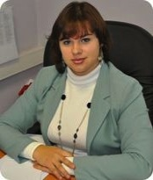
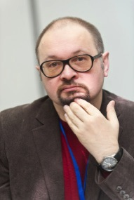
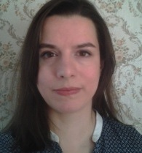
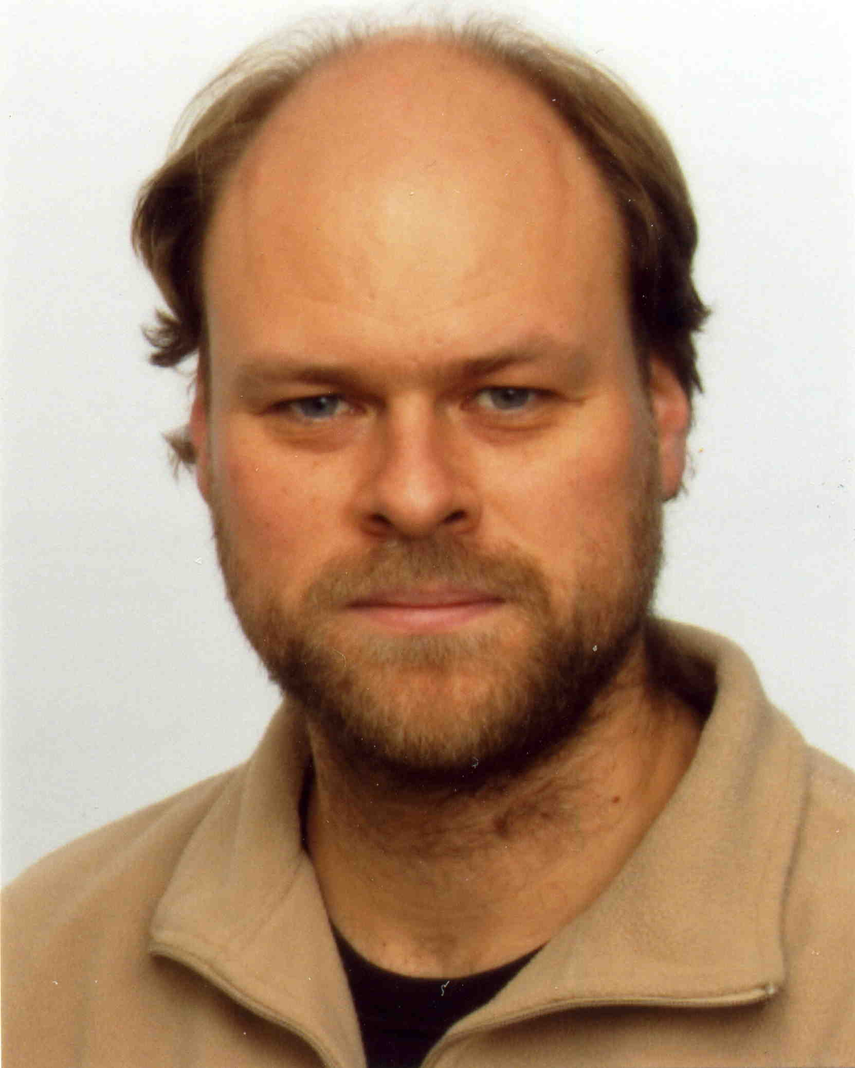
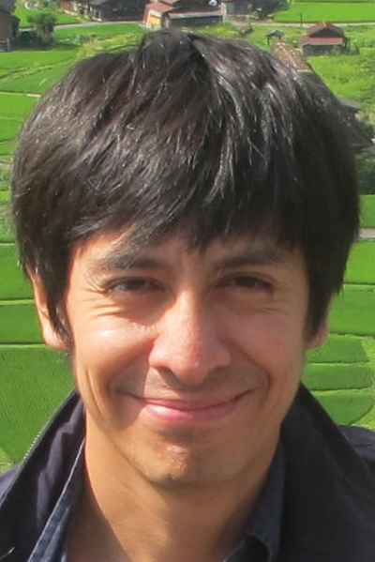
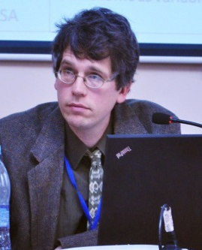
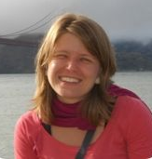
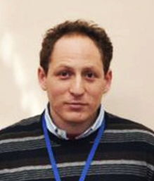
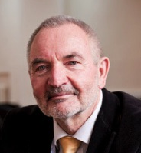
International pool of lecturers (2015-2016)
NRU-HSE: Chares Demetriu, Tatiana Karabchuk, Anna Nemirovskaya, Eduard Ponarin, Lili Di Puppo, Kyungmin Baek, Ruben Flores, Christian Fröhlich
photo
LCSR network guest lecturers: Joshua Dubrow (Polish Academy of Sciences, IFiS-PAN), Malgorzata Mikucka (Ceps/Instead, Esch-sur-Alzette, Luxemburg), Francesco Saraccino (STATEC Luxemburg), Peter Schmidt (University of Giessen), Christian Welzel (Leuphana University Lueneburg)
photo
photo
Higher School of Economics , Moscow, 2015

Slide 11
International partner institutions
photo
photo
photo
Higher School of Economics , Moscow, 2015

Slide 12
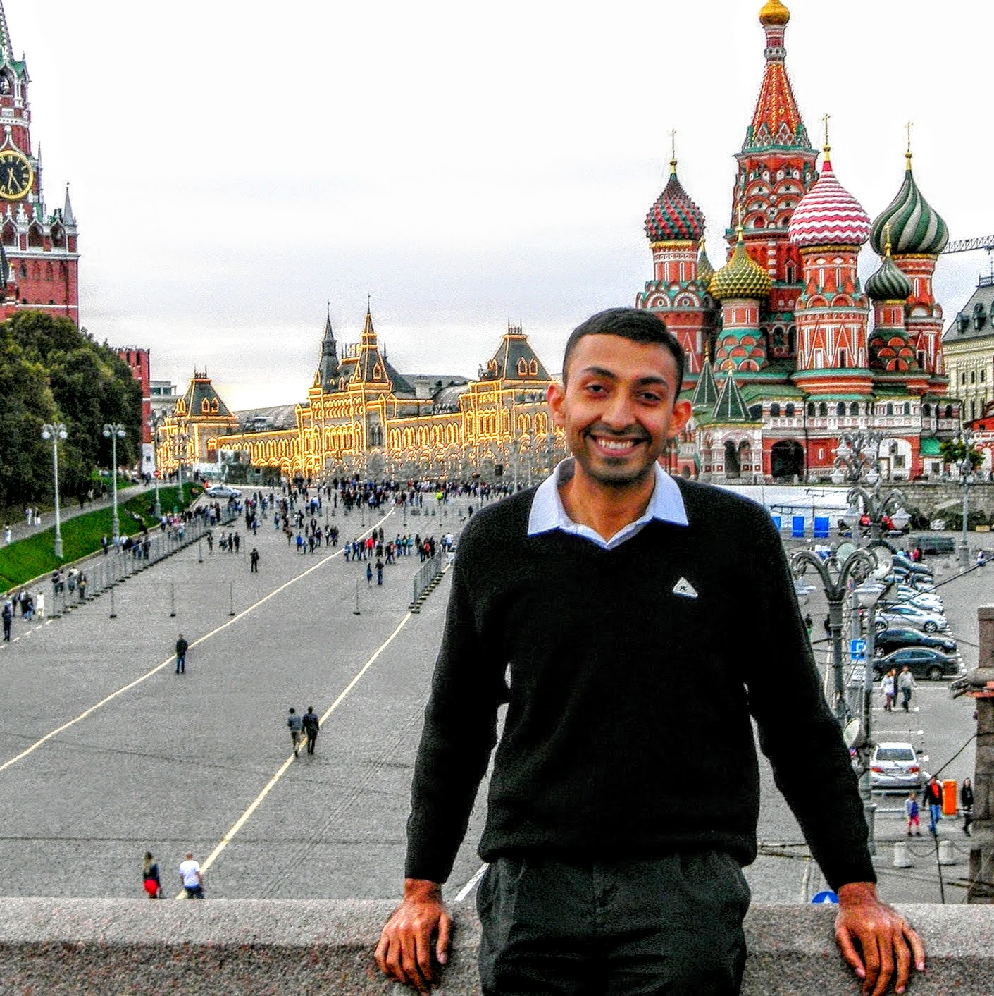
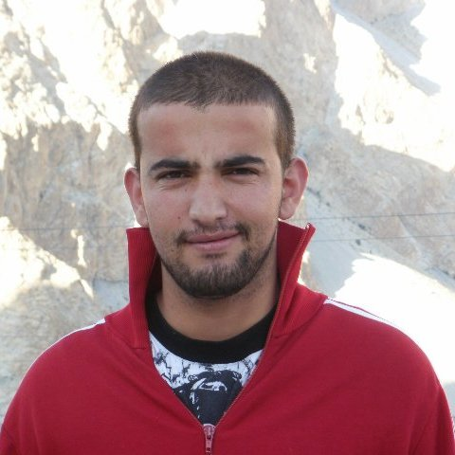
Impressions of our international students
“I chose the MA CSR program because of its promising blend of Social Science theory. I have certainly not been disappointed! The program is quite as I hoped it would be, and I look forward to every class as there are so many wonderful insights to gain.”
(Abhinav Banerjee, India, 1st year student)
photo
“The Master’s program at HSE in Comparative Social Research offered me a great opportunity to
get out of my comfort zone and learn something novel. The program gave me the freedom to pursue research in my area of interest, which could help me to a great deal for my further studies.”
(Karim Khan, Pakistan, 2nd year student)
photo
photo
Higher School of Economics , Moscow, 2015

Slide 13
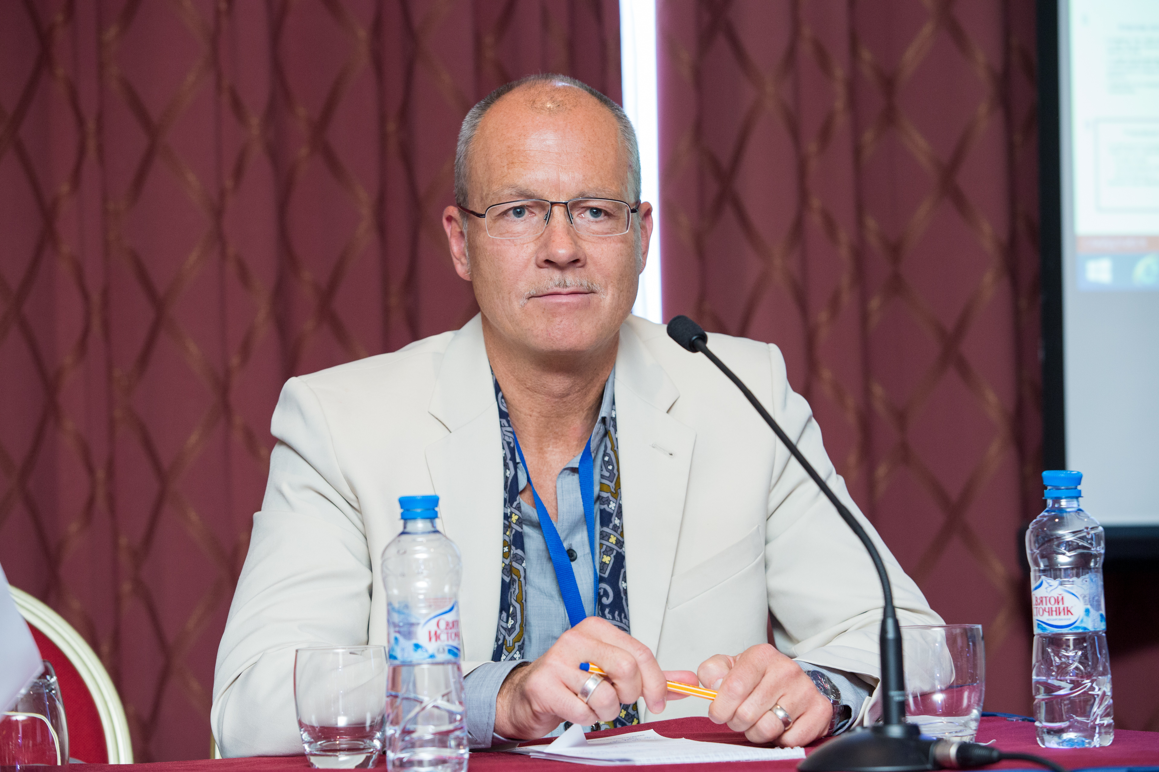
Impressions of our lecturers
photo
„NRU/HSE has established a world class MA program in Comparative Social Research. Its major strength is how it synergizes dedication, skill and diversity among both its student body and faculty. This program has created a real spirit.“
(Christian Welzel, University of Lüneburg, Germany)
photo
photo
Higher School of Economics , Moscow, 2015

Slide 14
Application
Portfolio application (CV, motivation letter, research statement, two recommendations, transcripts of previous educational studies, English certificate, GRE if available) - http://www.hse.ru/ma/csr
HSE Olympiad: 13./14.02.2016 (registration deadline 01.02.2016)
Application window:
Early admissions deadline: March 30th 2016
Regular admissions period: June 1st to July 15th 2016
photo
photo
photo
Higher School of Economics , Moscow, 2015

Slide 15
Student presentation
photo
photo
photo
Higher School of Economics , Moscow, 2015

Slide 16
Questions and answers
Program website:
http://www.hse.ru/en/ma/csr
Email:
interMA_CompSoc@hse.ru
tboldyreva@hse.ru
photo
photo
photo
Higher School of Economics , Moscow, 2015

Slide 17
20, Myasnitskaya str., Moscow, Russia, 101000
Tel.: +7 (495) 628-8829, Fax: +7 (495) 628-7931
www.hse.ru

