Slide 1
Dynamics and quality of WebRDS
Stanislav Moiseev, Yuliya Savinkova
“Web Survey Methodology” Research Group, NRU HSE
http://soc.hse.ru/en/online/

Slide 2
Agenda
Respondent-Driven Sampling (RDS)
Research questions
Methods & Data
Results

Slide 3
Social research go online
52% of all marketing surveys were online In 2012*
BUT we still have problems with online survey sampling
*According to the ESOMAR statistics

Slide 4
RDS
RDS – is a network sample which is starts from “seeds” – initial respondents selected and motivated by researcher
1. Respondents maintain reciprocal relationships with individuals whom they know to be members of the target population.
2. Respondents are all linked to a single component in the network.
3. Sampling is with replacement.
4. Respondents can accurately report their personal network size or, equivalently,
their degree.
5. Peer recruitment is a random selection of the recruiter’s peers.

Slide 5
Research questions
Critics insist that assumptions are non-realistic, and impugn quality of the research conducted with RDS (Goel at al. 2010).
Q1: Does final sample comply with the RDS assumption about random selection of the recruiter’s peers; reciprocal relationships between the respondent and members of target population; and ability of the respondent to accurately report their degree?
There is no data about influence of the personal acquaintance on the RDS dynamics and quality.
Q2: How personal acquaintance between researchers and seeds influence on the on sample dynamics and quality?

Slide 6
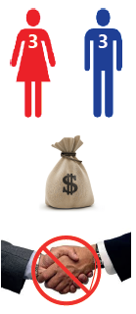
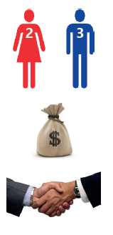
Data collection
2 online-surveys based on WebRDS in the period from February to June 2013
WebRDS-1
WebRDS-1
WebRDS-2
WebRDS-2

Slide 7
Results: RDS assumptions
Both samples did correspond RDS assumptions about reciprocal relationships between the respondent and members of target population and ability of respondents to accurately report their degree.
 | WebRDS-1, %% | WebRDS-2, %%
Friend | 64,2 | 65,8
Acquaintance | 34,3 | 34.2
Do not know before the research | 1,5 | 0

Slide 8
Results: RDS assumptions
Both samples did not correspond to the random selection requirement.
 | Statistical population | WebRDS-1, %% | WebRDS-2, %%
Male | 46 | 32 | 22
Female | 54 | 69 | 78

Slide 9
Results: dynamic and quality
The sample with seeds personally connected to the researchers had much more effective dynamic of growth:
2 times faster
No reminders
Same result

Slide 10
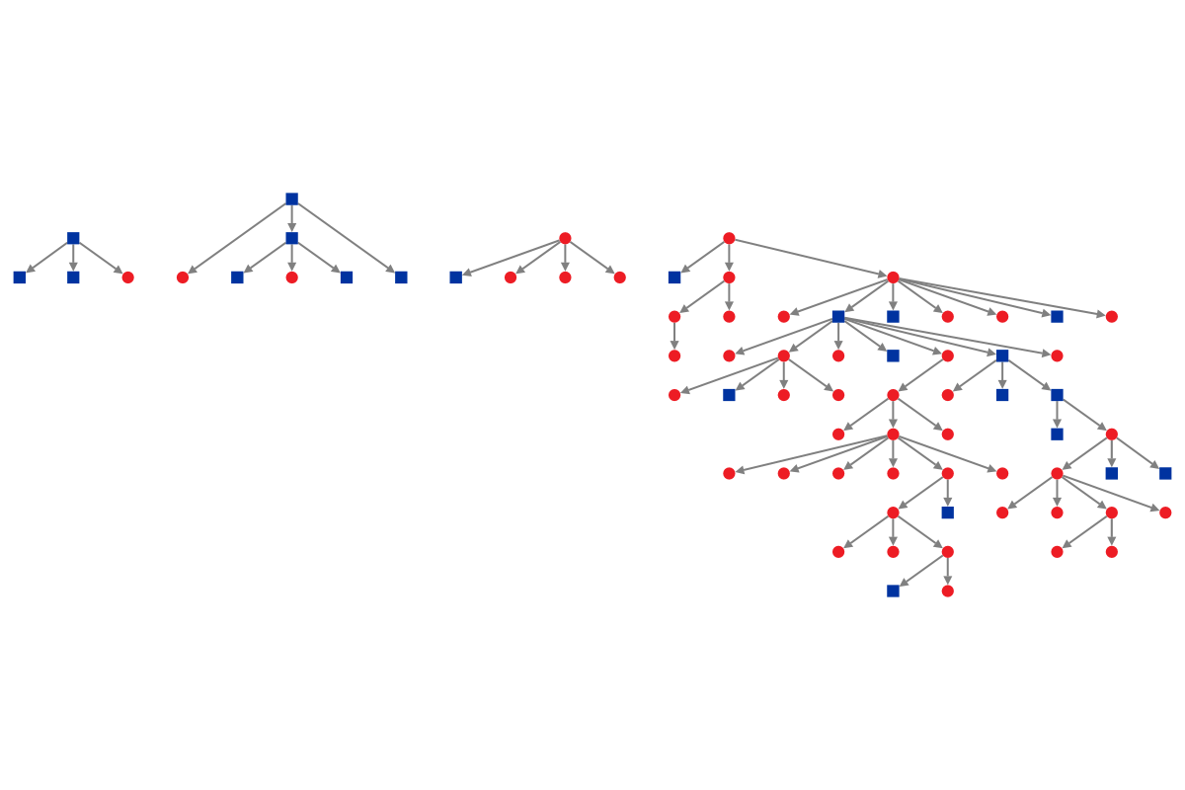
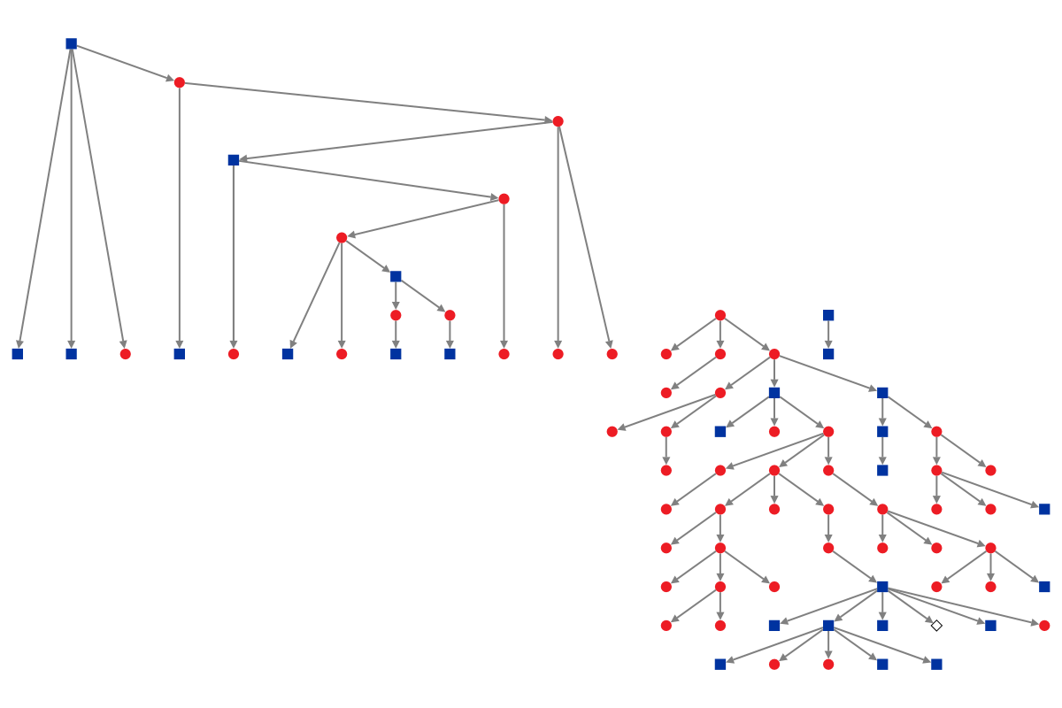
Results: dynamic and quality
WebRDS-1
WebRDS-2

Slide 11
Results: dynamic and quality
Graph Metrics | WebRDS-1 | WebRDS-2
Vertices | 72 | 79
Maximum Vertices in a Connected Component | 56 | 56
Maximum Geodesic Distance (Diameter) | 13 | 12
Average Geodesic Distance | 5,285183 | 5,814577

