Slide 1
Andrey Bykov, Inna F. Deviatko Experimental study of assessment of altruistic actions: effects of the survey mode
Web Survey Methodology Research Group
Higher School of Economics
April, 23, 2012

Slide 2
Experimental design
Four-factor model for assessment of altruistic actions (2*2*2*2=16 vignettes)
Full intra-subjective experimental plan – every participant had to assess all the 16 vignettes
Self-report Altruism Scale as inter-subjective factor
Two modes of experiment: ‘traditional’ paper-and-pencil (PP) questionnaire VS web-based (WB) questionnaire

Slide 3
Experimental model
Factors | Description in vignettes
Factor A | Degree of relatedness
Level 1 | X is Y’s uncle
Level 2 | X is someone of Y’s acquaintance
Factor B | History of interactions
Level 1 | X seldom helped Y in the past
Level 2 | X frequently helped Y in the past
Factor C | Donation size
Level 1 | X needs 1000 rubles to pay the rent for his apartment
Level 2 | X needs 50 000 rubles to pay for the surgery
Factor D | Possibility for meeting in the future
Level 1 | Y does not know for sure whether he will meet X in the near future
Level 2 | Y knows for sure that he will meet X in the near future

Slide 4
Experimental design
The factors’ levels were systematically varied across the vignettes, so that each participant assessed all the possible combinations
After reading each vignette the participants were asked to assess whether Y should give X the required donation using 11-point scale ranging from 0 (absolutely should not) to 100 (absolutely should)

Slide 5
Self-report Altruism Scale (SRA)
A Likert-like scale which contains 20 items describing different forms of altruistic actions (giving money to charity, donating blood, helping strangers, etc.)
The participants were asked to recall the frequency of making such actions (never, once, more than once, often, very often) and put it in the questionnaire. The score ranged from 1 (never) to 5 (very often)
The sum of all the items’ scores was treated as individual ‘index of altruism’

Slide 6
The questionnaire
We used 2 different types of random sequences of vignettes in the questionnaire
In each type the vignettes were set either before the SRA scale or vice versa. Therefore, we had 4 different questionnaires.
In the end we asked the participants if it was easy or difficult for them to fill in the questionnaire
PP and WB questionnaires were maximally identical in terms of design (2 vignettes per page, 10 SRA items per page)

Slide 7
Sample
In total, we had 166 participants (73 in PP mode and 93 in WB mode)
All the participants in PP mode were HSE students. No payment or other reward was given for the participation.
The participants of WB mode were students of HSE and other Russian universities. We used different forms of recruiting: personal request, personal invitation, advertisement in a social network. In this mode, no reward was given to participants either.

Slide 8
Results
First, we used one-way ANOVA to compare means on each vignette in the PP an WB modes. No significant differences were found
T-tests also did not show significant differences between the modes
Although, according to both Kolmogorov-Smirnov and Shapiro-Wilk tests, the scores on each vignette were not normally distributed

Slide 9
Results
 | sample_type
 | online | offline
 | Mean | Mean
A1B1C1D1_1 | 50,43 | 55,62
A1B2C1D1_2 | 82,37 | 81,78
A2B1C1D1_3 | 36,45 | 37,40
A2B2C1D1_4 | 73,44 | 70,55
A1B1C1D2_5 | 61,40 | 63,56
A1B2C1D2_6 | 85,59 | 87,26
A2B1C1D2_7 | 44,30 | 46,71
A2B2C1D2_8 | 78,92 | 80,41
A1B1C2D1_9 | 55,59 | 56,58
A1B2C2D1_10 | 72,47 | 73,56
A2B1C2D1_11 | 30,75 | 30,41
A2B2C2D1_12 | 61,94 | 60,14
A1B1C2D2_13 | 57,31 | 58,36
A1B2C2D2_14 | 80,86 | 82,33
A2B1C2D2_15 | 43,01 | 41,78
A2B2C2D2_16 | 70,43 | 69,59

Slide 10
Tests of Normality
 | Kolmogorov-Smirnovª |  |  | Shapiro-Wilk
 | Statistic | df | Sig. | Statistic | df | Sig.
A1B1C1D1_1 | ,120 | 166 | ,000 | ,970 | 166 | ,001
A1B2C1D1_2 | ,197 | 166 | ,000 | ,865 | 166 | ,000
A2B1C1D1_3 | ,135 | 166 | ,000 | ,957 | 166 | ,000
A2B2C1D1_4 | ,153 | 166 | ,000 | ,931 | 166 | ,000
A1B1C1D2_5 | ,107 | 166 | ,000 | ,960 | 166 | ,000
A1B2C1D2_6 | ,251 | 166 | ,000 | ,726 | 166 | ,000
A2B1C1D2_7 | ,099 | 166 | ,000 | ,972 | 166 | ,002
A2B2C1D2_8 | ,153 | 166 | ,000 | ,885 | 166 | ,000
A1B1C2D1_9 | ,115 | 166 | ,000 | ,970 | 166 | ,001
A1B2C2D1_10 | ,147 | 166 | ,000 | ,932 | 166 | ,000
A2B1C2D1_11 | ,125 | 166 | ,000 | ,938 | 166 | ,000
A2B2C2D1_12 | ,120 | 166 | ,000 | ,963 | 166 | ,000
A1B1C2D2_13 | ,110 | 166 | ,000 | ,968 | 166 | ,001
A1B2C2D2_14 | ,216 | 166 | ,000 | ,859 | 166 | ,000
A2B1C2D2_15 | ,110 | 166 | ,000 | ,973 | 166 | ,002
A2B2C2D2_16 | ,160 | 166 | ,000 | ,943 | 166 | ,000
a. Lilliefors Significance Correction

Slide 11
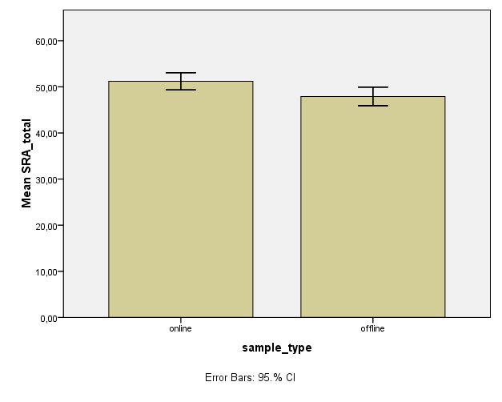
Results
SRA scale was normally distributed
Curiously, we found that the mean SRA score in WB mode (51,22) was slightly, but significantly higher than in PP mode (47,92)
ANOVA
SRA_total
 | Sum of Squares | df | Mean Square | F | Sig.
Between Groups | 444,632 | 1 | 444,632 | 5,745 | ,018
Within Groups | 12693,206 | 164 | 77,398
Total | 13137,837 | 165

Slide 12
Results
We found that the participants spent significantly more time filling in the WB questionnaire (mean 873 seconds against 531 in PP)

Slide 13
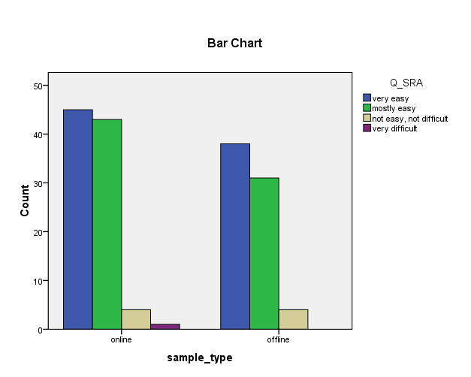
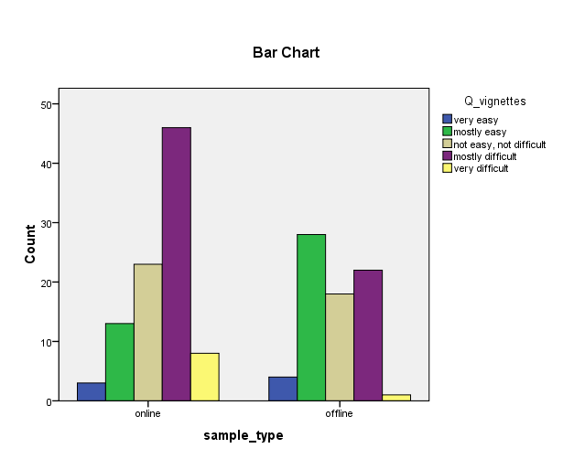
Results
We also found out that the participants in WB mode considered the part of questionnaire with vignettes to be more difficult than those in PP mode

Slide 14
Discussion
Our results are, in general, consistent with previous findings that there are no significant differences in participants’ assessments of (in our case) vignettes in PP and WB mode. This can mean that the researchers can use WB questionnaires as equivalents of ‘traditional’ PP without a considerable threat to the validity of data
However, we also found some differences between the two modes

Slide 15
Discussion
The difference between WB and PP modes in SRA scale is surprising. Although it is very slight, we can speculate about the possible causes.
Only one-half of those who have seen the first page in WB mode completed the questionnaire. That’s quite understandable, because the participants had to assess a big number of vignettes which seem to them almost identical –and this process requires time and effort. So, we can suppose that those of participants who actually completed the whole questionnaire were ‘more altruistic’ (because the didn’t experience direct normative pressure for completing – as the participants of PP mode did with an experimenter standing by in the classroom)
However, this hypothesis needs testing in further experiments with more rigid control for the recruiting procedure

Slide 16
Discussion
The difference in the time of completing the questionnaire is quite understandable
The presence of an experimenter motivated the participants of PP mode to concentrate on the questionnaire. As a result, they completed the questionnaire faster
The participants of WB mode, in turn, didn’t feel direct normative pressure for completing (being – we suppose – at home, in front of their computers). They could also perform some other activities (surfing the Internet or having lunch), so the time of completing the questionnaire was longer

Slide 17
Discussion
Finally, the difference in perceiving the difficulty of vignettes can be explained in terms of peoples’ expectations of the Internet-based activity. Surfing is something that usually takes almost no effort, people frequently surf the Web just because they have nothing to do. So ,it is not surprising that they perceive the assessment of 16 vignettes, a procedure that requires much intellectual effort and deliberative thinking, as a kind of a difficult process

Slide 18
Thank you for your attention!

