Slide 1
Mindfulness, Biofeedback, and Healing Rhythms
Irina Khramtsova, Ed.D.
Associate Professor of Psychology
Arkansas State University

Slide 2
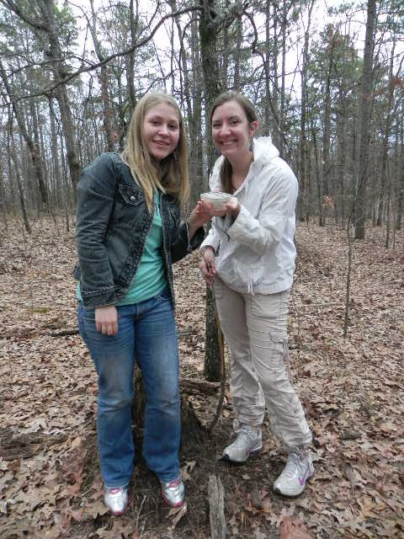
Introduction: What do we want in life?
Peace and happiness?
Or stress and negativity?

Slide 3
It’s easy to be peaceful and happy when everything around you is peace and happiness

Slide 4
What can I do?
College presents students with many challenges which
result in high anxiety and stress.
College presents students with many challenges which
result in high anxiety and stress.
College presents students with many challenges which
result in high anxiety and stress.

Slide 5
Types of Coping
Active (change behavior or circumstances)
Passive (avoidance)
Cognitive (change your thinking and attitude)
*But you will only be ready to make changes if you become aware of your current way of thinking and believe that you can improve it

Slide 7
Mindfulness
Paying attention in a non-judgmental way
Watching one’s thoughts but not being drawn into them
Being aware of the here and now
Being awake
Not the same as positive thinking
Is the opposite of mindlessness, which is running one’s life on an “automatic” pilot

Slide 8
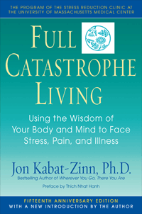
“Mindfulness is a lifetime’s journey along a path that ultimately leads nowhere, only to who you are”
(Kabat-Zinn, 2009)

Slide 9
Measuring mindfulness: Mindful Attention Awareness Scale
Brown, K.W. and Ryan, R.M. (2003). The benefits of being present: The role of mindfulness in psychological well-being. Journal of Personality and Social Psychology, 84, 822-848.
http://www.psych.rochester.edu/SDT/measures/maas_description.php

Slide 10
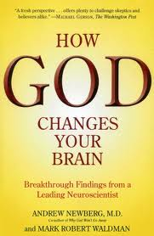
Can mindfulness be cultivated?
YES! Say Shapiro et al. (2008) in their article “Cultivating mindfulness: Effects on well-being”
Kabat-Zinn’s Mindfulness Based Stress Reduction Program (MBSR)
YES! Say Newberg and Waldman (2009)
and it changes your brain
Yes, - say Khramtsova and Glascock (2010)
http://www.ipsihologie.ro/images/stories/revista2010_34/art_03_glascock.pdf

Slide 11
Positive Effects of Mindfulness
Physiological effects: better physical health
Psychological effects : better mood, decrease in depression
Cognitive: clarity of thinking, improved memory
Ex., Meditation lowers stress and supports forgiveness among college students (Oman et al., 2008)

Slide 12
Correlates of mindfulness
Positive correlations
Negative correlations
positive affect
life satisfaction
self-esteem
subjective vitality
self-actualization
autonomy
competence
relatedness
Negative affect
Depression
Self-consciousness
Anxiety
Angry hostility
Brown and Ryan (2003)

Slide 13
Meditation
In Richard Davidson’s lab at the U. Wisconsin Madison:
Students who contemplated “compassion” significantly raised the energy level in the left frontal lobe (happiness center).
Depressed people taught Autogenic Training prevented relapse over the next three years.
Buddhist meditators are the happiest people that Davidson has studied in his lab.

Slide 14
Neurofeedback Research
Research by Miguel Nicolelis, Duke University, with rhesus monkeys on neurofeedback:
implanted electrodes into a monkey’s brain that detected the monkey's motor intent and thus were able to control reaching and grasping movements performed by a robotic arm.
Was done by decoding signals of hundreds of neurons recorded in volitional areas of the cerebral cortex while the monkey played with a hand-held joystick to move a shape in a video game.
These signals were sent to the robot arm, which then mimicked the monkey's movements and thus controlled the game.
After a while the monkey realized that thinking about moving the shape was enough and it no longer needed to move the joystick. So it let go of the joystick and controlled the game purely through thought.

Slide 15
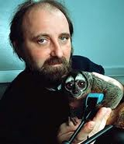
Mindfulness versus Mind Control
http://www.youtube.com/watch?v=PTVVYYxY9Cs
http://www.youtube.com/watch?v=gnWSah4RD2E&feature=related

Slide 16
If mindfulness is so wonderful, why don’t most of us practice it?
Some of the reasons are:
Low awareness of the benefits of something that is unseen and hard to measure
Our culture teaches us to keep our minds busy since early age
It is scary to look inside ourselves and see what we don’t like
It is difficult and frustrating to discipline our minds

Slide 17
How can we practice mindfulness?

Slide 18
Biofeedback
becoming aware of physiological functions using instruments that provide information on the activity of these systems (e.g., skin conductance or temperature, heart rate).
The purpose is to learn to control them at will and eventually, be able to do it without the equipment;
Is used to improve health or performance.

Slide 19
How to Distinguish Legitimate Biofeedback Devices
1. Biofeedback devices utilize well-understood technologies to sense quantifiable physiological parameters.
2. This information is directly manifested to the individual who, at all times, is “in the driver’s seat”.
3. The individual, under their own conscious will, changes their physiological state until the sensors indicate the parameters are in some improved range.
Tania M. Slawecki, Ph.D. * Research Associate 105 Materials Research Laboratory * University Park * PA *

Slide 20
Two Types of Biofeedback We Use
emWave from HeartMath
By Quantum Intech
Biodots

Slide 21
Устройство emWave
Поскольку стресс нарушает сердечный ритм, если дать человеку некий ориентир, то это поможет «восстановить синхронизацию» между ритмами сердца, нервной, гормональной и иммунной систем.
emWave, показывая в реальном времени уровень когерентности (согласованности) сердечного ритма, помогает избавиться от состояния стресса.
emWave помогает тренировать способность человека возвращаться из напряженного, неустойчивого состояния, в ритмичное, стабильное, характерное для хорошего самочувствия.

Slide 22
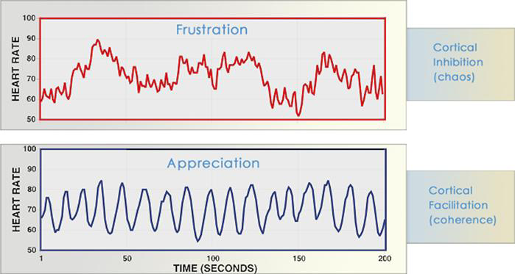
These graphs show examples of real-time heart rate variability patterns (heart rhythms) recorded from individuals experiencing different emotions.
-The incoherent heart rhythm characterized by its irregular, jagged waveform, is typical of stress and negative emotions such as anger, frustration, and anxiety.
-the coherent heart rhythm pattern is observed when an individual is experiencing a sustained positive emotion, such as appreciation, compassion, or love.
characterized by its regular, sine-wave-like waveform.
- the overall amount of heart rate variability is actually the same in the two recordings.

Slide 23
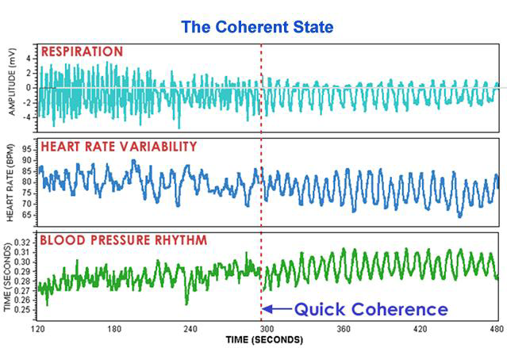
Physiological entrainment during coherence

Slide 24
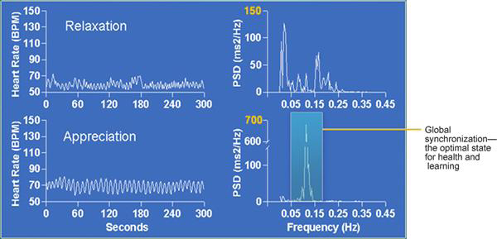
Relaxation produces a high-frequency, low-amplitude heart rhythm, indicating reduced autonomic outflow. Increased power in the high frequency band of the HRV power spectrum is observed, reflecting increased parasympathetic activity (the “relaxation response”). In contrast, the coherence state, activated by sustained positive emotions, is associated with a highly ordered, smooth, sine-wavelike
-Relaxation produces a high-frequency, low-amplitude heart rhythm, indicating reduced autonomic outflow. Increased power in the high frequency band of the HRV power spectrum is observed, reflecting increased parasympathetic activity (the “relaxation response”).
-The coherence state is associated with a highly ordered, smooth, sine-wavelike heart rhythm pattern.

Slide 25
Breathing and Coherence
Breathing modulates the heart’s rhythms
Coherence can be achieved by breathing slowly and regularly at a 10-second rhythm
This slow breathing can serve as a training tool at the initial stages of practicing coherence
It is also very helpful to break stressful emotional state
But…

Slide 26
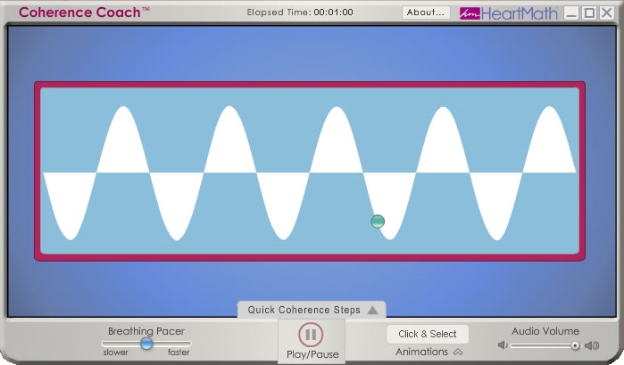

Slide 27
Breathing versus Positive Emotions
However, it is easier and more natural to maintain coherence through generation of positive emotions
Additionally, positive emotional states produce more benefits (e.g., improvements in cognition and performance, better hormonal balance)

Slide 28
How to Generate Positive Emotions
First, learn to be mindful and notice the mental negative chatter that your mind produces
Second, do not take this chatter seriously and do not judge yourself harshly
Third, consciously focus on something positive (gratitude, appreciation of beauty, love)

Slide 29
Practical Ways to Increase Positivity and Coherence
Journaling
Exercise
Praying
Inspiring literature
Relaxation
Nature
Art and creativity
And music

Slide 30
Vera Brandes, director, Research program in music and medicine, Paracelsus Private Medical University, Salzburg, Austria
Listening to finer music and attending concerts makes you four years younger and slows aging of arteries
Attending sports events offers none of these benefits
Healthiest people are singers
Play only natural instruments
Use only original music so that no associations can be made

Slide 31
Musical Pharmacology
Putting together the “active ingredients” of music which are blended into medicinal compounds
Treats psychosomatic disorders and pain, and “diseases of civilization”:
anxiety, depression, insomnia, arrhythmia.
Ex., Sand Art
http://www.youtube.com/watch?v=JGbJoifOzuA&feature=related

Slide 32
Healing Music
Healing music enhances emotional well-being and mental clarity and reduces stress, fatigue, and negative feelings (McCray, Barrios-Choplin, Atkinson, & Tomasino, 1998)
Noise and certain types of music have negative effects (e.g., increased hostility and tension in humans, diminished growth of plants, decreased cognitive development in children)

Slide 33
Rhythmic Medicine by Janalea Hoffman
Musical Biofeedback – lowers blood pressure and heart rate
Musical Acupuncture – alleviates pain
Musical Massage – has calming effect

Slide 34
HealthRhythms Drumming
Remo HealthRhythms Group Empowerment
Reduces stress and strengthens immune system
Improves mood
Empowers and provides social support
Provides exercise for the body and mind

Slide 35
Drumming to De-Stress on ASU campus April 2011

Slide 36
ASU Positive Psychology Club
Positive Psychology at ASU (on Facebook)
Mindfulness
Oneness/Unity Consciousness
Art Therapy
Music Therapy
Drumming

Slide 39
Our Current Research: Mindfulness and Oneness Consciousness
My research question: What is a more effective way to practice mindfulness with biofeedback: individually or in a group setting?
15 minutes of listening to a modified metta meditation
Followed by 15 minutes of mindfulness and emWave with or without music
Ex., Social closeness increases salivary progesterone in humans (Brown, Fredrickson , Wirth , Poulin , Meier , Heaphy , Cohen, Schultheiss, 2009)
..\positive psych\ProgesteroneBrown_Fredrickson_et_al_2009.pdf

Slide 40
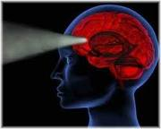
Final Comments
Intention and motivation
Mindfulness is essential to happiness because you increase your awareness and create more of what you want in life and less of what you do not want
There are different ways to practice it and we have to find what works for us
The best method is the one you practice on a regular basis

